Slide 1
Dazzling Dragonflies and Sparkly Spiders Parent Induction Information 2020
www.oxheyfirstschool.com

Slide 2
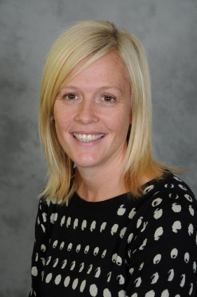
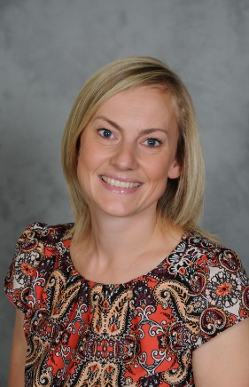
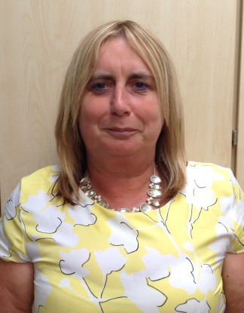
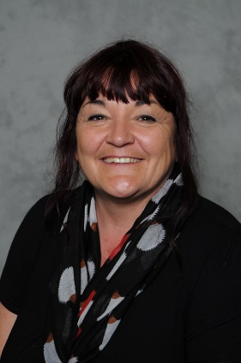
Meet our Dazzling Dragonflies and Sparkly Spiders Team!
Early Years Team
Mrs Fletcher
Teacher
Dazzling Dragonflies
EYFS Lead
Mrs Holt Teacher
Sparkly Spiders
Inclusion Lead
Mrs Petznik
Teaching Assistant
Dazzling Dragonflies
Mrs Bibby
Teaching Assistant
Sparkly Spiders

Slide 3

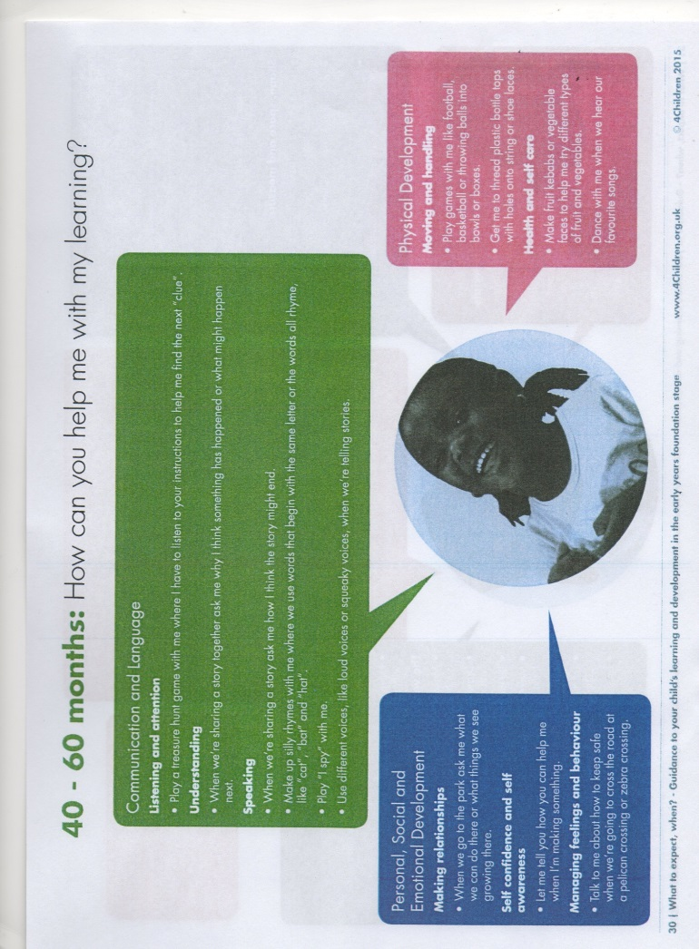
The Early Years Curriculum Expectations and How you can Help at Home
A copy of this was in the induction pack sent home.
www.4Children.org.uk

Slide 4

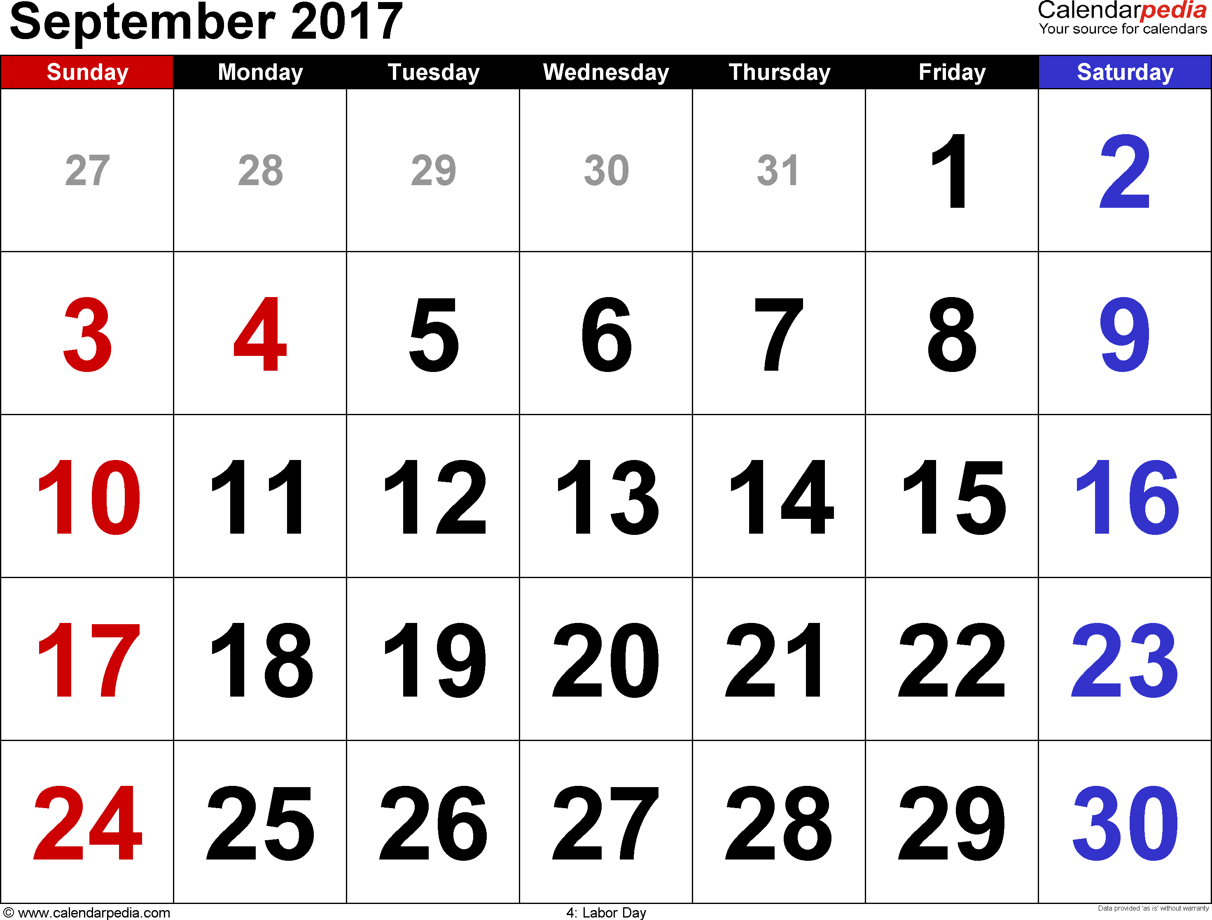
September Induction
In light of feedback from parents we offer a flexible approach to induction in September to suit the needs of parents and children. We will assume your child is joining us full time in September from day 1, unless you express a preference to design your own phased induction.

Slide 5

Home-School Communication
Member of staff on Early Years door daily – communication book
Child’s planner- for communication regarding your child’s reading
Appointments and class drop in sessions.
Email school office
Telephone – 01782 513000
Text message service
Please ensure school has your up to date contact details
Paperless school – check newsletter on website for regular dates
www.oxheyfirstschool.com

Slide 6
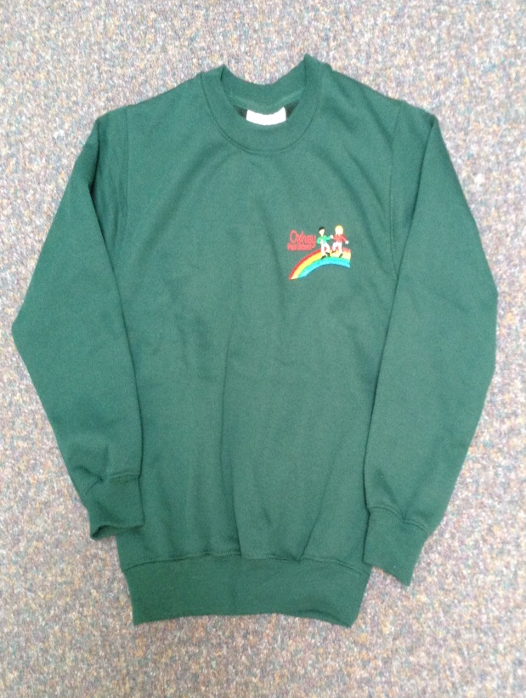
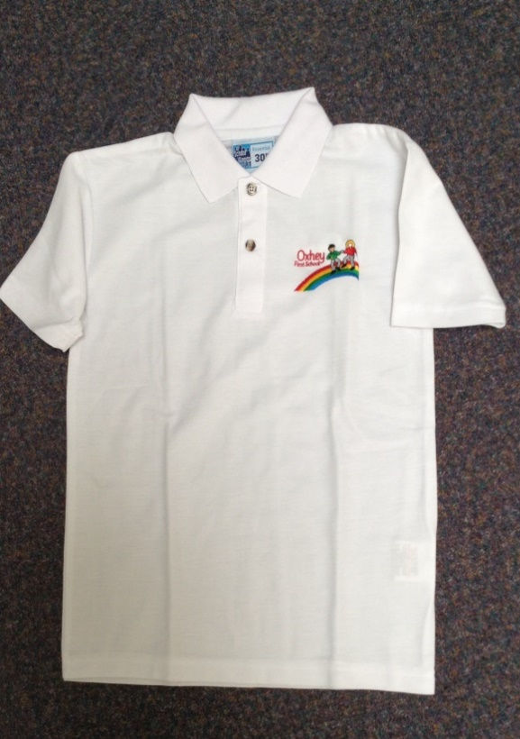
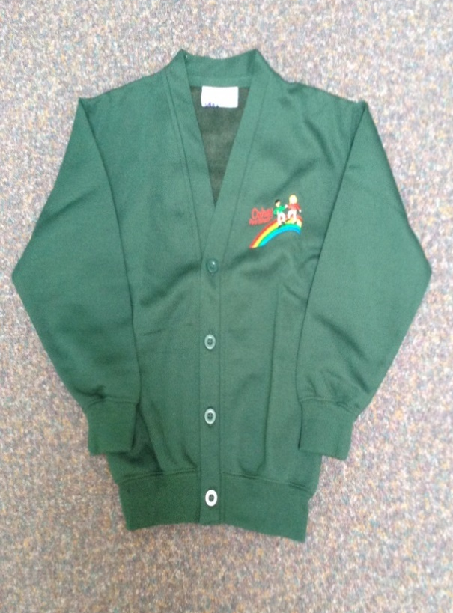

Our School Uniform

Slide 7
General
Information
Uniform- see slide
PE kit – available from school in bag, not needed until Summer term
Jewellery not allowed for PE-1 pair of studs may be worn and a watch at all other times. Please no jewellery on PE day ( day to be confirmed)
Bags – Reading bag only needed – important for home reading & planners
Names on EVERYTHING
Water bottles
Snack – free fruit scheme, water or milk, own labelled piece of fruit from home/pots
School dinners are provided free of charge by the government. Children may bring own packed lunch.
Poorly children to stay at home please for 48 hours after last symptoms of sickness.
Early Years Foundation Stage Handbook- copy was sent home in the pack.
www.oxheyfirstschool.com

Slide 8


Structure of the Day
8.45 Main gates open – member of SLT on yard to greet parents and children
8.50 Class gate opened and – flexi drop-off (children encouraged to come into class without parents as soon as possible. Member of EY staff on the gate each day)
9:00am Doors locked for security (late entry via office after this time) Self registration/activities
9:15 Phonics
9:35 Literacy/Maths activities
(plus Continuous Provision & outdoor activities)
12:00 Lunch (15 hour nursery children go home or go to Little Ladybirds for the afternoon session)
1:00 Expressive Arts/Physical/Knowledge & Understanding of the World (outdoor play within the afternoon)
3:00 PSED/Story/Singing/Assembly
3.15 - Home time- collected from small yard

Slide 9
Parental Engagement
Autumn Term Events
Regular Newsletter
Parent workshop evening- Curriculum/phonics
Parent Play and Stay/Shine sessions
Secret Story Teller
Half termly homework challenges
Christmas Fayre
Christmas Performance

