Slide 1
Welcome to KS1

Slide 2
KS1 Class Structure
KS1 is arranged into three mixed Year 1 and 2 classes.
Amazing Alligators
Teacher: Miss McGeady T.A.: Mrs. Critchlow
Perfect Pandas
Teacher: Mrs. Cooper T.A.: Mrs. Stonier
Terrific Turtles
Teacher: Mrs. Taylor T.A.: Mrs. Munro

Slide 3
Oxhey Uniform
Children are asked to wear full school uniform:
Green jumper or cardigan
White t-shirt or shirt
Grey trousers, skirt or pinafore dress
Grey shorts or green checked summer dress
Black shoes (boots can be worn in bad weather, with a change of shoes in bags)

Slide 4
Reading
Children will take home a home reading book of a level suitable for them.
Children who are reading pink, red, yellow, blue, green, orange and turquoise books will be asked to read their book 3 times before it is changed.
Children reading purple, gold and white books will be asked to read their books twice.
If your child takes part in Phonics lessons at school, they will also bring home a second phonics book, matched to the sound they are currently learning.
Please sign your child’s planner when they have read so we know when they are ready for a new book.

Slide 5
Phonics
Phonics is an approach to the teaching of reading by breaking words down into the individual sounds and spellings.
Daily phonics sessions in targeted groups take place every morning.
At Oxhey, we use the ‘SoundsWrite’ phonics scheme.
This is a methodical approach that introduces sounds progressively and allows children to secure their phonic recognition.

Slide 6
English
English will be linked with our Discovery topics, as well as covering different genres of writing, such as:
Stories
Instructions
Explanations
Non-chronological reports
Information texts
Poetry
Diaries
Recounts
To name but a few!

Slide 7
Maths
Throughout the year, we will cover a range of units, for example:
Number and Place Value
Addition and Subtraction
Multiplication and Division
Fractions
Geometry (Shape)
Statistics (Data Handling)
Times tables - To begin with 2s, 5s and 10s, moving onto 3s and 4s.
Measure

Slide 8
The CPA Approach to Maths
The CPA approach helps pupils to develop a deep understanding of maths as part of mastery learning.
It involves moving from concrete materials, to pictorial representations, to abstract symbols and problems.

Slide 9
CPA is for everyone!
The CPA approach is valuable for children of all abilities and ages to deepen and clarify mathematical thinking.
Children are given the opportunity to explore new concepts, discover new ideas, spot patterns, solve problems and use reasoning.
Learners are more secure in their understanding, as they have to prove that they have fully grasped an idea in a variety of ways.
A broader provision within the relevant year group embeds skills, rather than rushing children through the curriculum.
CPA is proven to give children a firm foundation for future learning.

Slide 10
Discovery Curriculum
The curriculum topics run across all classes in Key Stage 1 and cover a range of subjects including:
Geography
Music
History
Art
Design and Technology
When possible, Science will also link with the discovery topic being taught.

Slide 11
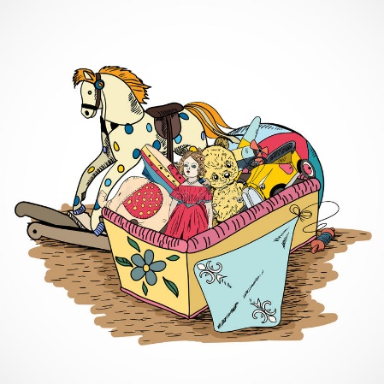
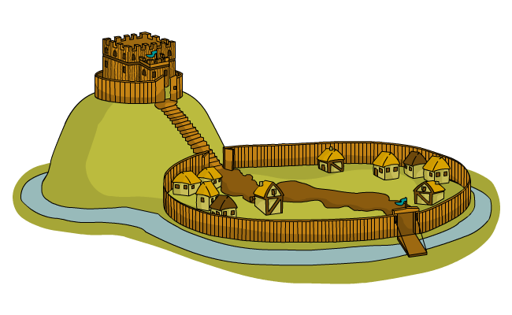
Discovery topics this year
Key Stage 1 have one topic for each term.
Autumn: Toy Story
Spring: Castles
Summer: Nemo in the Reef
Throughout the year, all areas of the National Curriculum for the relevant year group are covered via the Discovery topic.

Slide 13
Writing Across the Curriculum
As well as exploring various genres within English lessons, children will have opportunities to apply their writing skills through their topic lessons.
For example, an English unit on Information Texts would lead onto writing an Information Text based on Castles.
This embeds the writing skills learnt in English lessons, provides opportunities to write for a purpose and allows children to engage more deeply in their topic work.

Slide 14
Promoting Independence
In all lessons we try to ensure children take responsibility for their learning. We aim to promote independence in a variety of ways in the classroom, including:
Working walls
Access to concrete equipment
Word mats
Peer assessment
‘5 B's’ – Brain, Board, Book, Buddy, Boss

Slide 15
Happy learners make great progress!
Various activities throughout the school day focus on promoting the children’s wellbeing and allowing them to reflect on their learning, relationships and feelings for example:
Emotion boards
Worry boxes
Circle times
Assemblies

Slide 16
Assessment
Ongoing assessment happens throughout the term.
You will receive a termly report identifying the attainment and progress of your child in reading, writing and maths.
‘Tiger Learning’ is also reported and shows how your child is progressing with a range of skills which support how they learn and work with others.
T – Travis works hard
I – Indi ignores distractions
G – Gustav works well in a group
E – Enid is enthusiastic
R – Rita takes risks with learning

Slide 17
National Assessments
In the Autumn term, Year 2 children will take their Phonics screening assessment which they were not able to complete in the summer.
In the summer term, all KS1 children take part in a national assessment.
Year 1: Phonics Screening
Year 2: SATS tests (Reading, Writing, Maths)
Further information regarding these assessments will be provided to the relevant year group during the year.

Slide 18
Homework
Homework this term will consist of:
Daily reading of home reader
Daily reading of phonics books (where applicable)
Times Tables Rockstars (when appropriate for Year 1).
Spellings practice

Slide 19
Spellings
Spellings are sent home on Friday.
Children will have a combination of high frequency exception words for their year group, and words with their current phonics/Spelling rule focus.
Please support your child with learning the spelling/phonics patterns at home.
The test will take place every Thursday and their score will be recorded in their planners.

Slide 20
Learning Online
The school subscribes to several online learning providers: PurpleMash, EducationCity and Times Tables Rockstars.
Children can access these at home at any time; there are lots of fun games and activities to support your child’s learning.
Personal log-in and password details for all three online resources will be stuck in the front of your child’s planner.

Slide 21
P.E.
P.E. in Key Stage 1 takes place on a Thursday afternoon.
Throughout the year, children will take part in:
Dance
Gymnastics
Games
On Thursdays, children will need to come to school in their P.E. kit.
White t-shirt
Green shorts (In colder weather, children can also wear dark-coloured jogging bottoms or leggings)
Trainers/pumps

Slide 22
Forest School
This year, all classes have been scheduled a 4 week block of Forest School sessions in the school grounds.
Children will take part in a variety of outdoor activities led by specialist Forest School teacher, Mr. Fox.
Children will need a set of weather-appropriate clothes that you are happy to get very mucky!
Due to Covid, we will not be able to have parent sessions this time.
Perfect Pandas | Terrific Turtles | Amazing Alligators
14th Sept. | 12th Oct. | 16th Nov.
21st Sept. | 19th Oct. | 23rd Nov.
28th Sept. | 2nd Nov. | 30th Nov.
5th Oct. | 9th Nov. | 7th Dec.

Slide 23
Snack
The free fruit scheme has now resumed so all KS1 children are able to have a piece of fruit at morning break.
The children can bring in an extra piece of fruit if they would like a snack during their afternoon playtime.
Lunch
Lunch is from 12:10pm – 1:10pm.
All KS1 children are entitled to a free school meal.

Slide 24
Drop off
The current drop off times for the three Key Stage 1 classes are below:
Perfect Pandas = 8:50am
Terrific Turtles = 9:00am
Amazing Alligators = 9:00am
Please keep to the allocated times to ensure that there is a steady flow around the school to support social distancing.
If you have siblings with different drop off times, please drop off your youngest child at their allocated slot and then your older child afterwards even if this is after the older child’s allocated time. Your child will not be marked as late.

Slide 25
Pick Up
The current pick up times for the three Key Stage 1 classes are below:
Perfect Pandas = 3:10pm
Terrific Turtles = 3:20pm
Amazing Alligators = 3:20pm
Please keep to the allocated times to ensure that there is a steady flow around the school to support social distancing.
Please collect your youngest child at their allocated slot and then your older child afterwards even if this is after the older child’s allocated time. This will not count as a late pick up.

Slide 26
Contacting School
If you have any questions or concerns, your first point of contact is your class teacher.
All KS1 class teachers have a drop-in hour straight after school every Thursday.
Please do not use the class teacher’s email for general information or to advise your child is off sick. Please use the office email for this.
Following this, you can make an appointment with Mrs. Cooper as Assistant Headteacher/Key Stage 1 leader.
If you have further queries, appointments can be made with Mrs. Jukes.

Slide 27
Please do not hesitate to get in touch if you have any questions. Thank you.

