Slide 1
Little Ladybirds Parent Induction Information 2020/Jan 2021
www.oxheyfirstschool.com

Slide 2
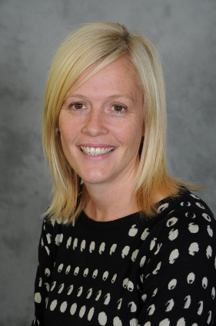
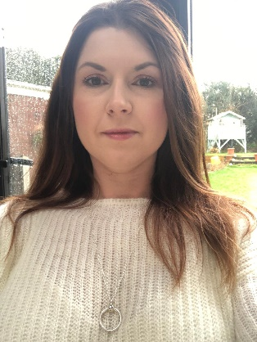
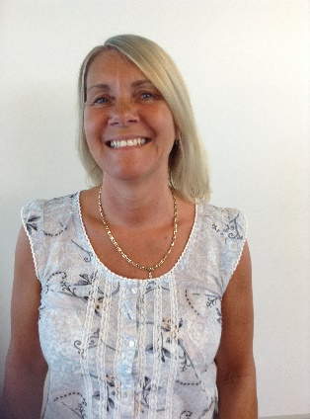
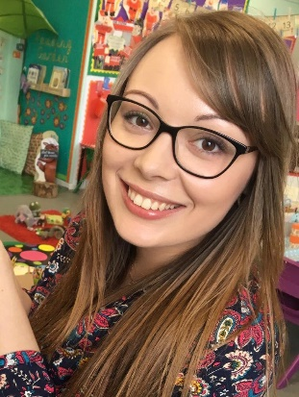
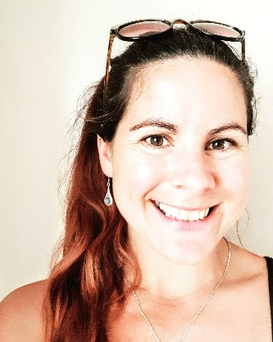
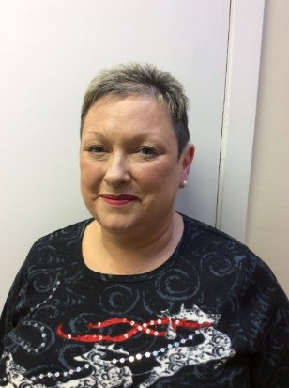
Meet our Little Ladybirds Team!
Mrs Fletcher
Teacher
EYFS Lead
Teacher in Dazzling Dragonflies
Mrs Christie
Teacher
Mrs Squires
Teaching Assistant
Miss Johnson
Teaching Assistant
Mrs Short
Teaching Assistant
Mrs Davies
Teaching Assistant

Slide 3
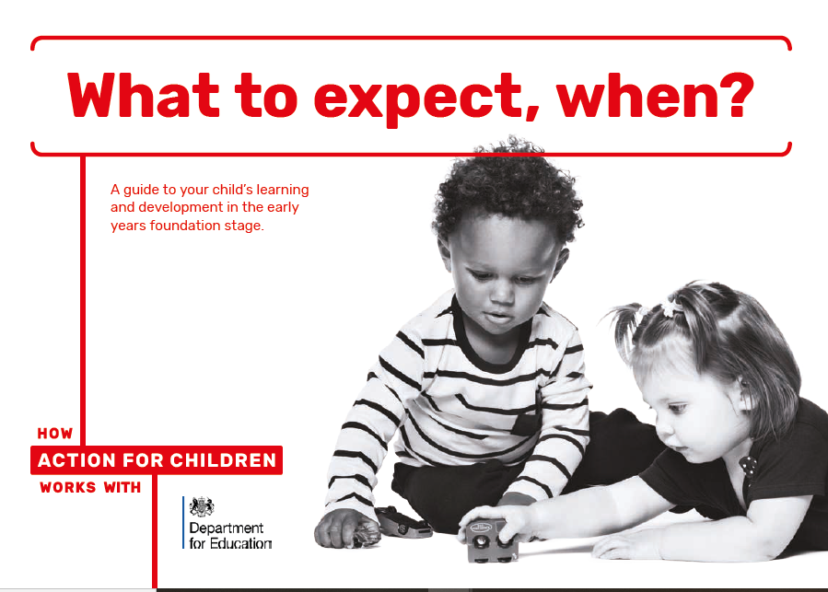

Slide 4
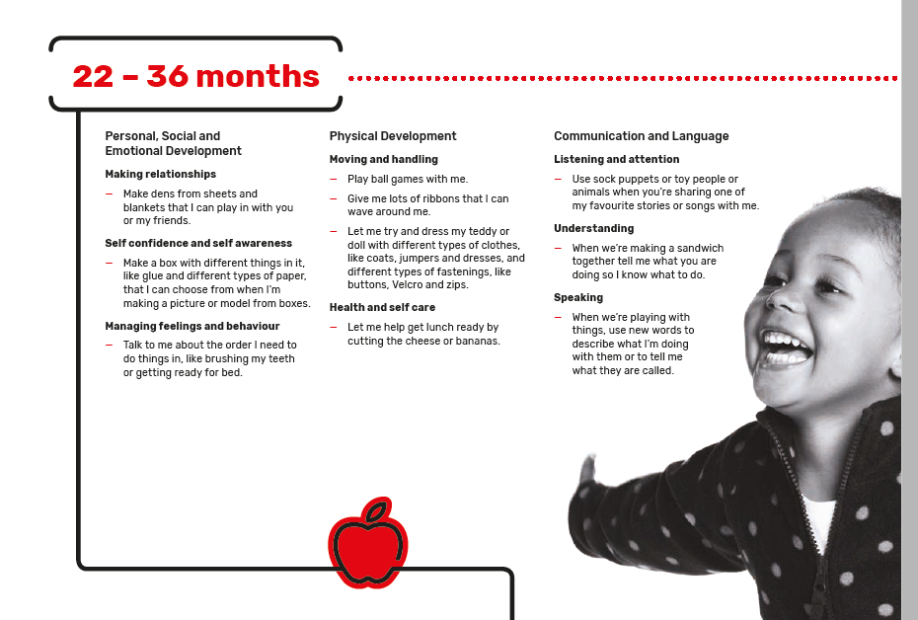

Slide 5
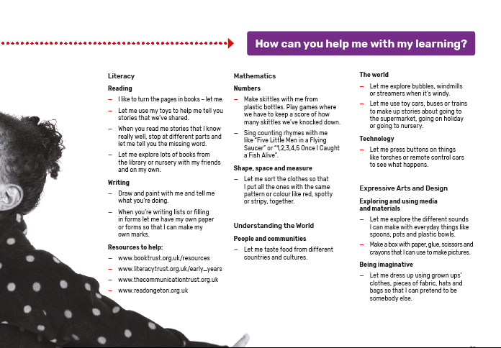

Slide 6
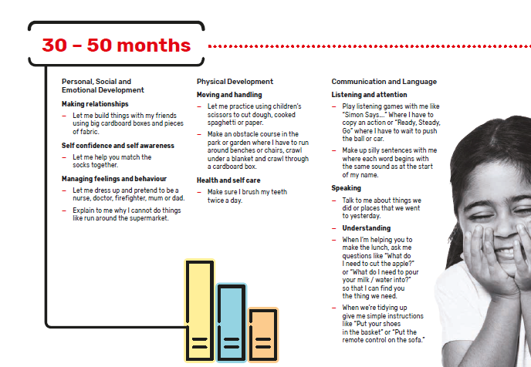

Slide 7
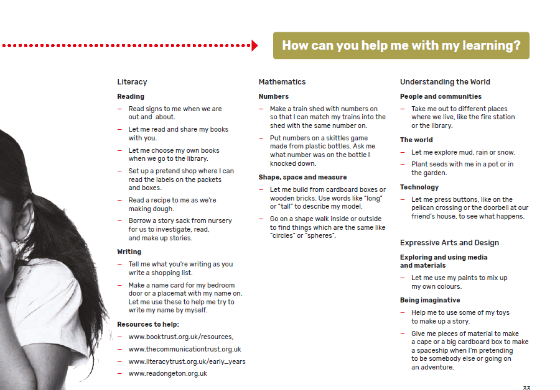

Slide 8
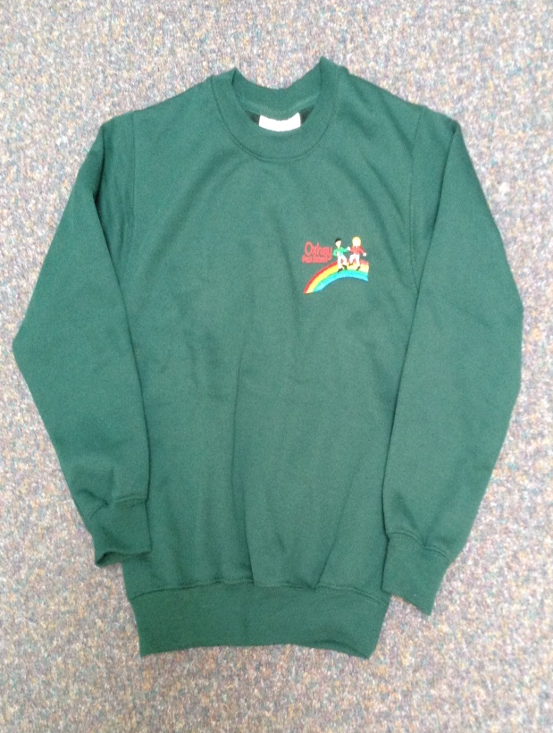
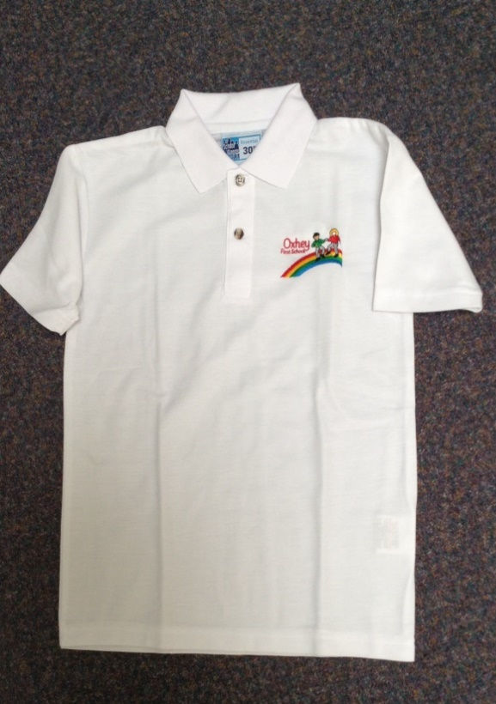
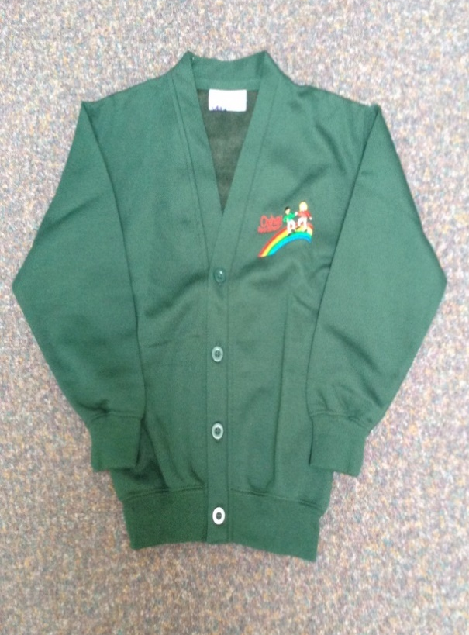
Our School Uniform
Grey pinafore/skirt Plain green or Oxhey logo Sweatshirts
Grey trousers Plain green or Oxhey logo Cardigans
Black shoes Plain white or Oxhey logo polo shirt
SCHOOL LOGO UNIFORM CAN BE PURCHASED FROM …
Smart School Uniform, Newcastle, 01782 713650
shop@smartuniform.co.uk

Slide 9

Home-School Communication
Member of staff on Early Years door daily – communication book.
Child’s planner – for communication regarding your child’s reading.
Mrs Christie’s ‘Phone in’ will be Wednesday’s after school if you need to discuss anything, please call the office number
Email school office
Telephone – 01782 513000
Text message service
Please ensure school has your up to date contact details
Paperless school – check newsletter on website for regular dates
www.oxheyfirstschool.com

Slide 10


Structure of the Day
8.45 Gates open- Please wait on the blue spots
8.45 Class doors open and self registration (children encouraged to come into class without parents as soon as possible. Member of EY staff on the door each day)
9:00 Teacher led input
9:20 Teacher-Led activities, indoors and outdoors
Plus Continuous Provision Activities
10.15 snack time
11.15 Phonics
11.30 Story
11.45 Home/ Lunch (if staying for afternoon Extended Nursery)
3:00 Children collected from small yard- Please wait on the blue spots

Slide 11
General
Information
Uniform
PE kit – not needed until Reception
Tree- Mendous Tuesday outdoor learning morning- children will need to come to school wearing warm clothing, a puddlesuit and wellies on Tuesdays. A change of shoes will be needed
Jewellery not allowed for PE. 1 pair of studs may be worn and a watch at all other times. Please no jewellery on PE day ( day to be confirmed)
Bags – Reading bag only needed – important for home reading & planners. A spare change of clothes may be provided in a labelled carrier bag to keep on your child’s peg
Names on EVERYTHING
Water bottles – water only please, no juice
Snack – fruit is provided my the free fruit scheme, or you may send in 1 piece of fruit if your child only likes certain things
Poorly children to stay at home please for 48 hours after last symptoms of sickness. Please bring them to the office on their return for a temperature check
If your child has Covid 19 symptoms then please do not bring them to school. Please check the guidance for Covid 19 on our website and arrange a test
If your child is staying for the whole day please ensure staff are aware of your child’s lunch arrangements. (Hot dinner £2.30, School Sandwich £2.30, Packed Lunch from home)
www.oxheyfirstschool.com

Slide 12
Parental Engagement
Weekly Newsletter
2 Simple updates
Parent workshop evening- curriculum*
Parent play and stay/SHINE session*
Secret Story Tellers*
Summer Fair*
(please note those marked with * are unable to go ahead at the moment)

