Slide 1
Welcome to KS1

Slide 2
KS1 Class Structure
KS1 is arranged into three mixed Year 1 and 2 classes.
Amazing Alligators
Teacher: Mrs Kane T.A.: Mrs. Critchlow and Mrs Barker
Perfect Pandas
Teacher: Mrs. Cooper T.A.: Mrs. Stonier
Terrific Turtles
Teacher: Mrs. Taylor T.A.: Mrs. Munro

Slide 3
Reading
Children will take home a home reading book of a level suitable for them.
Children who are reading pink, red, yellow, blue, green, orange, turquoise and purple books will be asked to read their book 3 times before it is changed.
Children reading gold and white books will be asked to read their books twice.
If your child takes part in Phonics lessons at school, they will also bring home a second phonics book, matched to the sound they are currently learning.
Please sign your child’s planner when they have read so we know when they are ready for a new book.

Slide 4
Phonics
Phonics is an approach to the teaching of reading by breaking words down into the individual sounds and spellings.
Daily phonics sessions in targeted groups take place every morning.
At Oxhey, we use the ‘SoundsWrite’ phonics scheme.
This is a methodical approach that introduces sounds progressively and allows children to secure their phonic recognition.

Slide 5
English
English will be linked with our Discovery topics, as well as covering different genres of writing, such as:
Stories
Instructions
Explanations
Non-chronological reports
Information texts
Poetry
Diaries
Recounts
To name but a few!

Slide 6
Maths
Throughout the year, we will cover a range of units, for example:
Number and Place Value
Addition and Subtraction
Multiplication and Division
Fractions
Geometry (Shape)
Statistics (Data Handling)
Times tables - To begin with 2s, 5s and 10s, moving onto 3s and 4s.
Measure

Slide 7
The CPA Approach to Maths
The CPA approach helps pupils to develop a deep understanding of maths as part of mastery learning.
It involves moving from concrete materials, to pictorial representations, to abstract symbols and problems.

Slide 8
CPA is for everyone!
The CPA approach is valuable for children of all abilities and ages to deepen and clarify mathematical thinking.
Children are given the opportunity to explore new concepts, discover new ideas, spot patterns, solve problems and use reasoning.
Learners are more secure in their understanding, as they have to prove that they have fully grasped an idea in a variety of ways.
A broader provision within the relevant year group embeds skills, rather than rushing children through the curriculum.
CPA is proven to give children a firm foundation for future learning.

Slide 9
Discovery Curriculum
The curriculum topics run across all classes in Key Stage 1 and cover a range of subjects including:
Geography
Music
History
Art
Design and Technology
When possible, Science will also link with the discovery topic being taught.

Slide 10
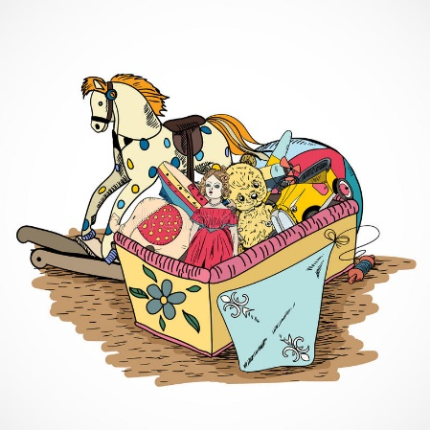
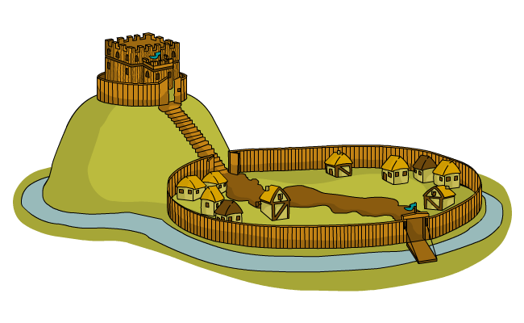
Discovery topics this year
Key Stage 1 have one topic for each term.
Autumn: London’s Burning
Spring: Arctic Adventures
Summer: Let’s go on holiday
Throughout the year, all areas of the National Curriculum for the relevant year group are covered via the Discovery topic.

Slide 12
Writing Across the Curriculum
As well as exploring various genres within English lessons, children will have opportunities to apply their writing skills through their topic lessons.
For example, an English unit on Information Texts would lead onto writing an Information Text based on Castles.
This embeds the writing skills learnt in English lessons, provides opportunities to write for a purpose and allows children to engage more deeply in their topic work.

Slide 13
Promoting Independence
In all lessons we try to ensure children take responsibility for their learning. We aim to promote independence in a variety of ways in the classroom, including:
Working walls
Access to concrete equipment
Word mats
Peer assessment
‘5 B's’ – Brain, Board, Book, Buddy, Boss

Slide 14
Happy learners make great progress!
Various activities throughout the school day focus on promoting the children’s wellbeing and allowing them to reflect on their learning, relationships and feelings for example:
Emotion boards
Worry boxes
Circle times
Assemblies

Slide 15
Assessment
Ongoing assessment happens throughout the term.
You will receive a termly report identifying the attainment and progress of your child in reading, writing and maths.
‘Tiger Learning’ is also reported and shows how your child is progressing with a range of skills which support how they learn and work with others.
T – Travis works hard
I – Indi ignores distractions
G – Gustav works well in a group
E – Enid is enthusiastic
R – Rita takes risks with learning

Slide 16
National Assessments
In the Autumn term, Year 2 children will take their Phonics screening assessment which they were not able to complete in the summer.
In the summer term, all KS1 children take part in a national assessment.
Year 1: Phonics Screening
Year 2: SATS tests (Reading, Writing, Maths)
Further information regarding these assessments will be provided to the relevant year group during the year.

Slide 17
Homework
Homework this term will consist of:
Daily reading of home reader
Daily reading of phonics books (where applicable)
Times Tables Rockstars (when appropriate for Year 1).
Spellings practice
Basic Skills/Homework menu

Slide 18
Spellings
Spellings are sent home on Friday.
Children will have a combination of common exception words for their year group, and words with their current phonics/Spelling rule focus.
Please support your child with learning the spelling/phonics patterns at home.
The test will take place every Thursday and their score will be recorded in their planners.

Slide 19
P.E.
P.E. in Key Stage 1 takes place on a Friday afternoon.
Throughout the year, children will take part in:
Dance
Gymnastics
Games
On Fridays, children will need to come to school in their P.E. kit.
White t-shirt
Green shorts (In colder weather, children can also wear dark-coloured jogging bottoms or leggings)
Trainers/pumps

Slide 20
Forest School
This year, all classes have been scheduled a 5 week block of Forest School sessions in the school grounds.
Children will take part in a variety of outdoor activities led by specialist Forest School teacher, Mr. Fox.
Children will need a set of weather-appropriate clothes that you are happy to get very mucky!
You will be invited along to a parent session this time.

Slide 21
Snack
The free fruit scheme has now resumed so all KS1 children are able to have a piece of fruit at morning break.
The children can bring in an extra piece of fruit if they would like a snack during their afternoon playtime.
Lunch
Lunch is from 12:00pm – 1:00pm.
All KS1 children are entitled to a free school meal.

Slide 22
Contacting School
If you have any questions or concerns, your first point of contact is your class teacher.
All KS1 class teachers have a drop-in 30 minute session straight after school every Thursday.
Please do not use the class teacher’s email for general information or to advise your child is off sick. Please use the office email for this.
Following this, you can make an appointment with Mrs. Cooper as Assistant Headteacher/Key Stage 1 leader.
If you have further queries, appointments can be made with Mrs. Jukes.

Slide 23
Please do not hesitate to get in touch if you have any questions. Thank you.

