Slide 1
KS2 Introduction Evening

Slide 2
Class Structure
KS2 is arranged into three mixed Year 3 and 4 classes.
Outstanding Owls
Teacher: Mrs. Nevitt T.A.: Mrs. Peach
Marvellous Meerkats
Teacher: Mrs Holt T.A.: Mrs. Wade
Fabulous Foxes
Teacher: Miss Walker T.A.: Mrs. Holt

Slide 3
Oxhey Uniform
Children are asked to wear full school uniform:
Green jumper or cardigan
Grey trousers, skirt or pinafore dress
Grey shorts or green checked summer dress
White t-shirt or shirt
Black shoes (boots can be worn in bad weather, with a
change of shoes in bags)
Green/black and white hair bobbles, clips and headbands

Slide 4
Reading
Children are individually heard to read at least once a week. Please ensure that your child has their home reading book in school each day.
Children will also take part in a guided reading session each week.
In Key Stage 2, we focus on both verbal and written comprehension, (with a big focus on inference skills) and we ask that when you are reading with your child at home that you ask them lots of questions.
Children are also encouraged to change their own reading book and record this in in their home reading diaries/planners

Slide 5
Reading Ladder
At Oxhey, we take part in a reading challenge. Children are asked to read at home at least 4x per on different days. Every morning, the children have the opportunity to move their name up the reading ladder.
The class with the most children successfully completing the reading challenge earn themselves an extra playtime at the end of the week.

Slide 6
English
English will be linked with our topics, as well as covering different genres of writing, such as:
Stories
Instructions
Explanations
Non-chronological reports
Information texts
Poetry
Diaries
Recounts
To name but a few!

Slide 7
Maths
We will be covering a range of units, for example:
Number and Place Value
Addition and Subtraction
Multiplication and Division
Fractions
Geometry (Shape)
Statistics (Data Handling)
Times tables - To begin with 3s, 4s and 8s, moving on to
6s, 7s and 9s, and eventually all x tables by the end of Year 4.
Measure

Slide 8
The CPA Approach to Maths
The CPA approach helps pupils to develop a deep understanding of maths as part of mastery learning.
It involves moving from concrete materials, to pictorial representations, to abstract symbols and problems.

Slide 9
Discovery Curriculum
The curriculum topics run across all classes in Key Stage 2 and cover a range of subjects including:
Geography
Music
History
Art
Design Technology
Science is taught discreetly based on the Year 3 and Year 4 curriculum expectations.
Each class will take part in one trip (or in-school educational day) every term.

Slide 10
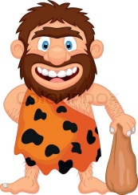
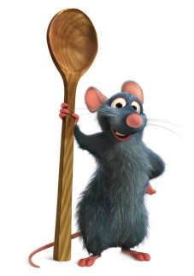
Discovery topics this year
Key Stage 2 have one topic for each term.
Autumn 1: The Croods
Autumn 2: The Potteries.
Spring 1: Ratatouille
Spring 2: Countries of the world
Summer: The Wild, Wild West
Throughout the year, all areas of the National Curriculum for the relevant year group are covered via the Discovery topic.

Slide 11
Promoting Independence
In all lessons we try to ensure children take responsibility for their learning. We aim to promote independence in a variety of ways in the classroom, including:
Working walls
Access to concrete equipment
Word mats
Peer assessment

Slide 12
Happy learners make great progress!
Various activities throughout the school day focus on promoting the children’s wellbeing and allowing them to reflect on their learning, relationships and feelings for example:
Emotion boards
Worry boxes
Circle times
Assemblies

Slide 13
Assessment
Ongoing assessment happens throughout the term.
You will receive a termly report identifying the attainment and progress of your child in reading, writing and maths.
‘Tiger Learning’ is also reported and shows how your child is progressing with a range of skills which support how they learn and work with others.
T – Travis works hard
I – Indi ignores distractions
G – Gustav works well in a group
E – Enid is enthusiastic
R – Rita takes risks with learning

Slide 14
Multiplication Check Y4
Children in Y4 are required to take the test
It takes place during the month of June and we have a three week window to complete the test
The children sit the test on a computer/laptop/electronic device and have 25 questions to answer in under 6 seconds per question
Children need to be confident in all of the 12x tables as the questions are random and are designed to test understanding of all these
We will ensure that children are prepared for this and that they feel relaxed and comfortable
Please practise times table with your children – TTtrockstars is great for building speed as is Maths Frame

Slide 15
Homework
Children will receive a homework menu at the start of each half term.
The menu will offer a variety of activities based on the children’s current topic and will cover all areas of learning.
Children are asked to complete one activity every other week, and can choose one of the activities from the menu across the half term.
Children to return their homework each week by Wednesday so that it can be marked.
Every other week there will be English and Maths basic skills homework set.

Slide 16
Spellings
Spellings are sent home on Friday.
Children will have a combination of common exception words, and spelling patterns they are learning in class.
Please support your child with learning the spelling patterns at home, and encouraging them to write them within a sentence.
The test will take place every Thursday.

Slide 17
Learning Online
The school subscribes to several online learning providers: My Maths and Times Tables Rockstars.
Children can access these at home at any time; there are lots of fun games and activities to support your child’s learning.
A personal log-in and password for these online resources will be added to the front of your child’s planner.

Slide 18
P.E.
P.E. in Key Stage 2 takes place on a Tuesday afternoon.
Throughout the year, children will take part in:
Invasion Games
Dance
Gymnastics
Swimming
Swimming is on a Tuesday afternoon each week. Outstanding Owls are swimming in the Autumn term, Fabulous Foxes are swimming in the Spring term and Marvellous Meerkats are swimming in the Summer term.
P.E. kit:
Indoor kit: Green shorts, white t-shirt, trainers/pumps.
Outdoor kit: Dark joggers or leggings, white t-shirt, trainers, dark hoodie or jumper in the winter months and for representing the school in festivals.

Slide 19
Forest School
This year, all classes have been scheduled a 4 week block of Forest School sessions in the school grounds.
Children will take part in a variety of outdoor activities led by specialist Forest School teacher, Mr. Fox.
Children will need a set of weather-appropriate clothes that you are happy to get mucky!
Parents are invited to attend the final session of the block.
Outstanding Owls | Fabulous Foxes | Marvellous Meerkats
17th January | 7th March | 25th April
24th January | 14th March | TBC May
31st January | 21st March | 9th May
7th February- parents | 28th March - parents | 16th May - parents

Slide 20
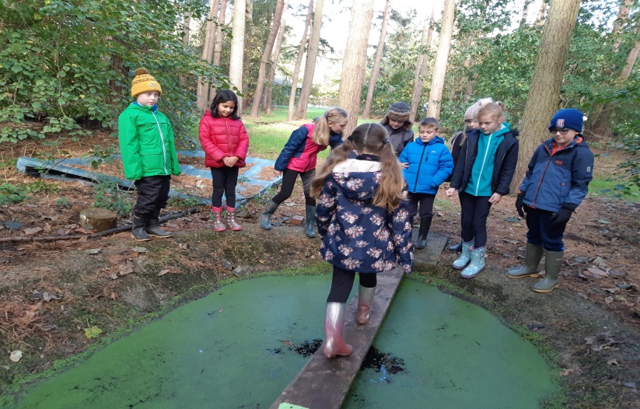
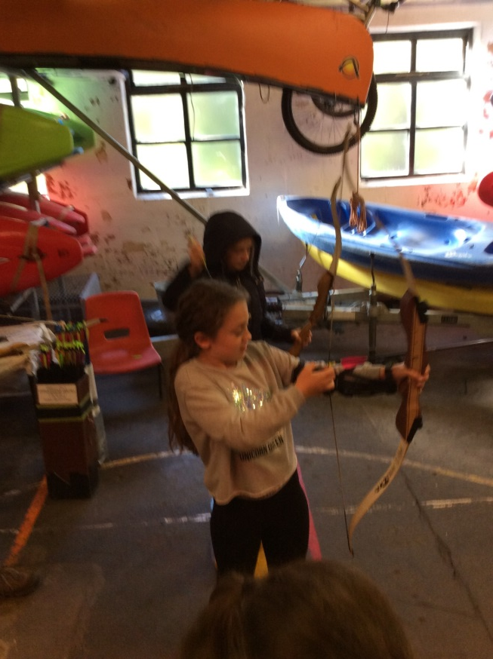
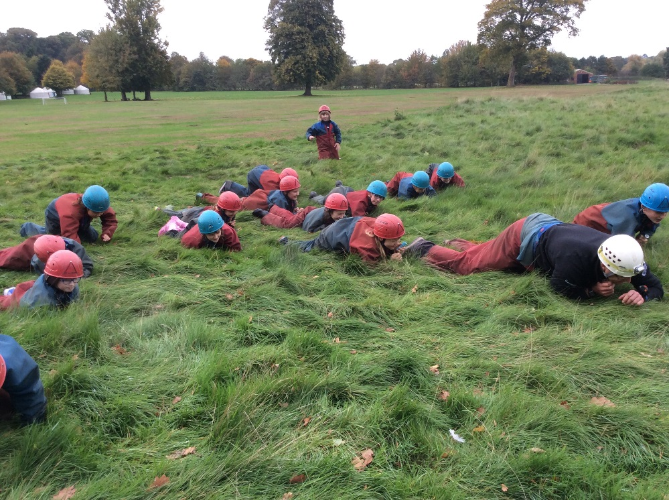
Standon Bowers!

Slide 21
Standon Bowers
Y4 Residential – Monday 14th March – Wednesday 16th March
Standon Bowers is in Stafford and children will spend time enjoying the outsides and building skills such as resilience, team work and long lasting friendships
More information will follow regarding costing and an information evening will be scheduled separately to discuss the structure of the residential

Slide 22
Pick Up
When collecting your children at 3.25pm, the children in Key Stage 2 are handed over to you from the top playground.
When collecting your child, please stand clear of the gate/pathway to assist in a safe handover, as it can get extremely busy on the side path.
If your child is being picked up by someone different than usual, please let the class teacher know.

Slide 23
Any Questions?
If you have any questions, we will all go to our classrooms to speak to you individually.
Thank you very much. ☺

