Slide 1
Phonics
Why teach phonics?
The ability to read and write well is a vital skill for all children, paving the way for an enjoyable and successful school experience.
Phonics helps children to develop good reading and spelling skills

Slide 2
Phase 1 in Phonics is not about learning the sounds with flashcards it is about getting ready to learn the sounds. It is primarily speaking and listening activities.
The emphasis during Phase 1 is to get children attuned to the sounds around them and ready to begin developing oral blending and segmenting skills.
Being secure in Phase 1 is vital to future success in phonics.
It is split into 7 aspects-
*General sound discrimination- environmental, instrumental and body
*Rhyme
*Alliteration
*Voice sounds
*Oral blending
It is really good fun!

Slide 3
How can I help at home?
Play ‘I spy’ with sounds not the alphabet names
Sing lots of nursery rhymes
Choses stories that use alliteration
Play pairs with words and pictures
Play sound bingo games
Play lots of party games like Musical statues
Read lots of rhyming books
Play the shopping bag game
Rhyming cards

Slide 4
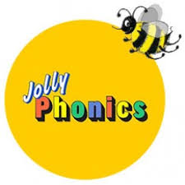
Jolly Phonics

Slide 5
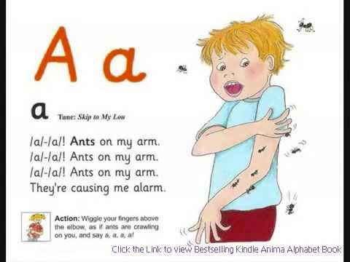
Jolly Phonics
Kinaesthetic and ‘fun’ approach to learning letter sounds.
Each sound has a ‘jolly jingle’ and an action

Slide 6
Sounds Write
Phonics Programme

Slide 7
What is Sounds Write?
A phonics programme which focuses on pure sound and encourages blending and segmenting of words from the very beginning.
No sound is taught in isolation – children learn a number of sounds at the same time:
e.g. a i m s t
Children will then build words using these sounds by listening, repeating and writing in every session.
am, at, as, sam, sat, sit, pat, pam, pit

Slide 8
The Initial Code
The ‘code’ refers to the sounds children are taught. Once they understand the code, they are able to read and write it!
Sounds are not taught in alphabetical order. The initial code works through the phonemes (sounds) in an order which enables them to build words as they go, and build on skills as well.
They are encouraged to “say the sounds” then “read the word”
e.g. s - i - t = sit
f – l – i – ck = flick

Slide 9
Skills | Code
cvc | a, i, m, s, t
 | n, o, p
 | b, c, g, h
 | d, e, f, v
 | k, l, r, u
 | j, w, z
 | x, y, ff, ll, ss, zz
vcc (ink) cvcc (jump) | no new code
ccvc (frog) | no new code
ccvcc (stink) cccvc (scrub) | no new code
 | sh, ch, th, ck, wh, ng, qu

Slide 10
The Initial Code Activities
The Sounds Write approach introduces a series of structured and repetitive lessons that introduce key skills to read and write. The lessons are repeated for each letter set within the code.
Throughout the phonics sessions children will learn to:
Build words
Search for sounds
Swap Sounds in words
Read and spell words

Slide 11
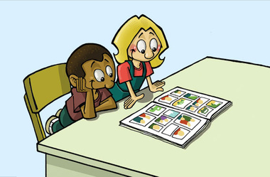
The Extended Code
In the extended code, children are taught that :
Many spellings represent more than one sound.
Many sounds can be represented by more than one spelling.
E.g.
/ae/ can be spelt
ay (play) ai (drain) ea (great) a-e (gate)

Slide 12
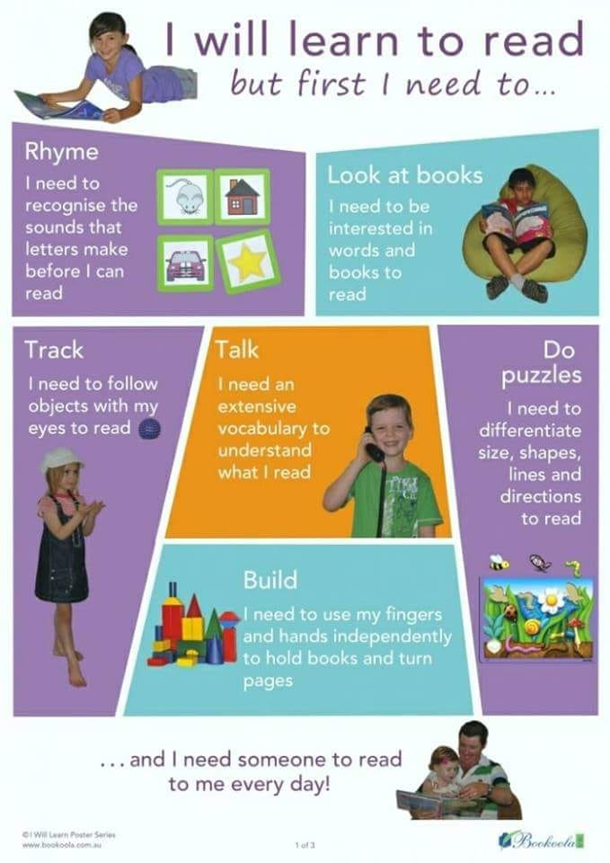

Slide 13
Helping your child to share books and read at home
‘Walk through’ – talk about pictures
Sound out words and blend together to read
You as the adult need to model this process.
Re-read sentence to make sure it makes sense.
Talk about the story together to
Make sure your child understands it.
Ask, which was their favourite part?
Are there any parts they did not like?
Can they relate it to their own
experience?
PLEASE WRITE IN PLANNER WHEN YOU HAVE HEARD YOUR CHILD READ (at least 3x a week) AND FEEL FREE TO COMMENT ON YOUR CHILDS ENJOYMENT OF THE BOOK.

Slide 14
Remember….
“The more that you read, the more things you will know. The more that you learn, the more places you'll go.”
Dr. Seuss, I Can Read With My Eyes Shut!

Slide 15
The Physical Aspect of Writing
Writing not only involves the phonetic side (being able to hear the sounds that make up a word) but the physical aspect of forming letters to write sounds down.
Our whole-school handwriting scheme, ‘Penpals’ teaches letter formation.
Pre-cursers to formal handwriting are important in the early years to develop dexterity and muscle memory.
‘Funky Fingers’
Dough Disco!

Slide 16
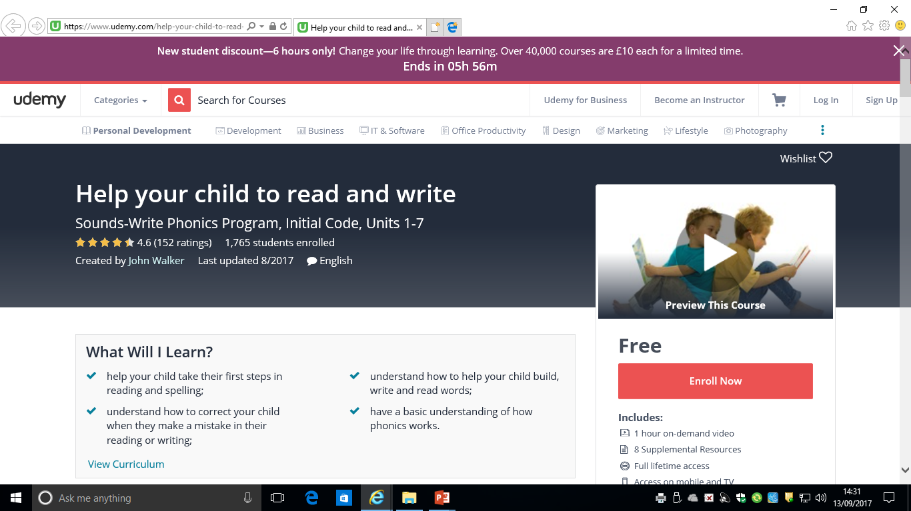
How you can help at home
https://www.udemy.com/help-your-child-to-read-and-write/

Slide 17
Mathematics in the new EYFS curriculum
Fast recognition of up to 3 objects, without having to count them individually (‘subitising’).
Recite numbers past 5.
Say one number for each item in order: 1,2,3,4,5.
Know that the last number reached when counting a small set of objects tells you how many there are in total (‘cardinal principle’).
Show ‘finger numbers’ up to 5.
Link numerals and amounts: for example, showing the right number of objects to match the numeral, up to 5.
Experiment with their own symbols and marks as well as numerals.
Solve real world mathematical problems with numbers up to 5.
Compare quantities using language: ‘more than’, ‘fewer than’.
Talk about and explore 2D and 3D shapes (for example, circles, rectangles, triangles and cuboids) using informal and mathematical language: ‘sides’, ‘corners’; ‘straight’, ‘flat’, ‘round’.
Understand position through words alone – for example, “The bag is under the table,” –with no pointing.
Describe a familiar route.
Discuss routes and locations, using words like ‘in front of’ and ‘behind’.
Make comparisons between objects relating to size, length, weight and capacity.
Select shapes appropriately: flat surfaces for building, a triangular prism for a roof etc.
Combine shapes to make new ones - an arch, a bigger triangle etc.
Talk about and identifies the patterns around them. For example: stripes on clothes, designs on rugs and wallpaper. Use informal language like ‘pointy’, ‘spotty’, ‘blobs’ etc.
Extend and create ABAB patterns – stick, leaf, stick, leaf.
Notice and correct an error in a repeating pattern.
Begin to describe a sequence of events, real or fictional, using words such as ‘first’, ‘then...’

Slide 18
Mathematics in the new EYFS curriculum

