Slide 1
Welcome to EYFS
website- oxhey.staffs.sch.uk

Slide 2

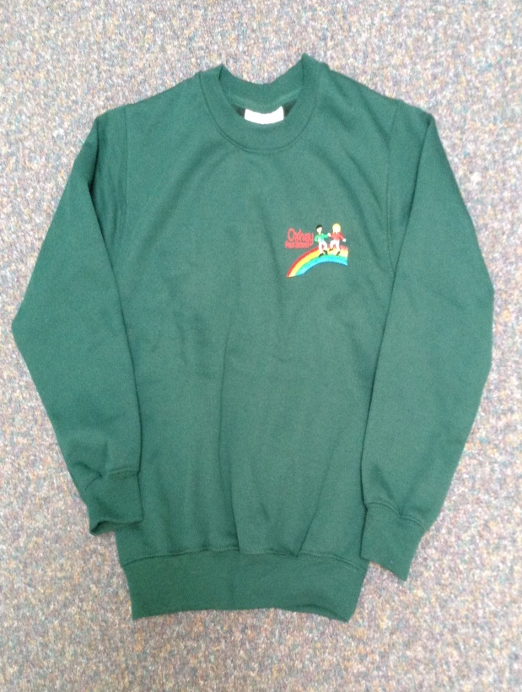
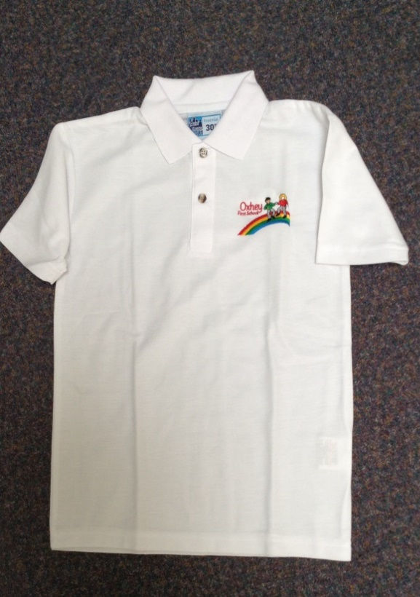
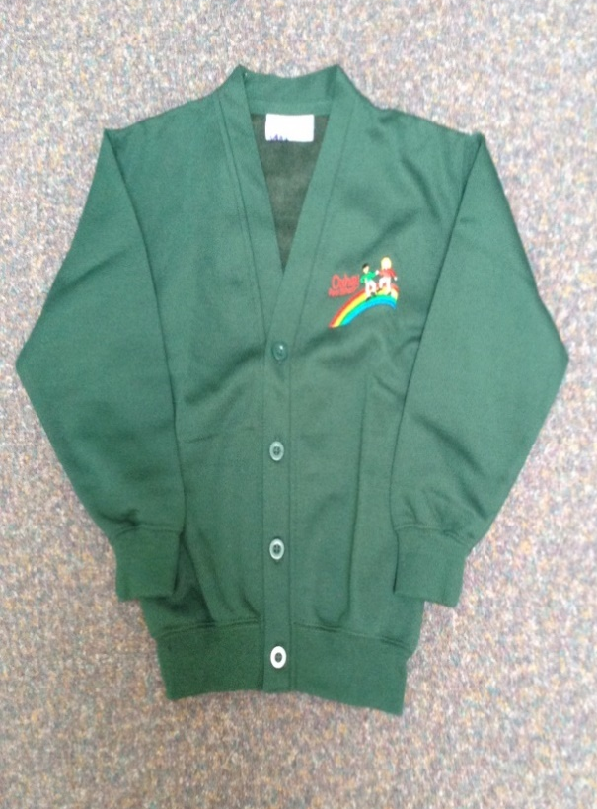

Our School Uniform

Slide 3
Remember drop off is flexible between 8.45- 9am to avoid congestion.
A member of staff will be on the door each morning- please pass on any messages as planners are not checked until reading days. Please make sure any other adults dropping off know to pass messages on.
Please take water bottles out of bags so they can put them away when they come in- they forget they have them!
PE kit –Children to come in kits. Earrings must be removed at home for PE – Wednesday for DD/ SS Thursday LL
Named Reading folders– please bring in every day.
Please record in your child’s planner when you have read with your child- At least 3X weekly at home before their book change day, 4x to achieve reading challenge prize
Proud clouds – non-academic achievements
Labell ALL items of clothing!!!
Labelled Wellies – to be kept in school please
Labelled Water bottles – water only, not juice please. Please ensure your child has a drink with packed lunch from home.
Snack –Fruit is provided. If preferred, 1 piece of fruit or fruit based snack (not yoghurts) from home may be sent in LABELLED. Free milk is also available.
Please check website regularly for news, letters and weekly updates.
Poorly children- if sickness/upset stomach please stay at home please for 48 hours after last symptoms!
Covid symptoms please see letter
If your child requires prescribed medicine please take it to the office and fill in the form.
Secret storyteller- please speak to class teacher if you would like to do this-
General
Information

Slide 4


If you would like to discuss any concerns….
Drop in sessions.
EYFS drop in is on Monday after school
Due to the current situation the ‘drop in’ will be a telephone consultation. Please call the office between 3.30 and 4pm. 01782 513000.
Please feel free to pass messages to the member of staff on the gate in the mornings or email or ring the office.

Slide 5
Up and coming events!
* CLASS MASCOTS
* Individual/ sibling photos 15th October
* Parents evening 21st October
* SHINE SESSIONS FOR CHRISTMAS CRAFT 14th Dec
* Reports 16th December
* Christmas holiday 17th Dec
*CHRISTMAS PERFORMANCE AM- 8th Dec/ PM 9th Dec
*FOREST SCHOOLS- DD 13th/ 20th/ 27th June
- SS 4th/ 11th/ 18th July
*FUNDRAISING EVENTS-
Macmillan coffee morning 24th sept- info to follow
CHRISTMAS FAYRE- Date to be confirmed
PLEASE SEE THE WEBSITE FOR FULL DETAILS OF PARENTAL ENGAGEMENT EVENTS.

Slide 6
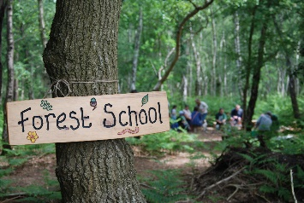
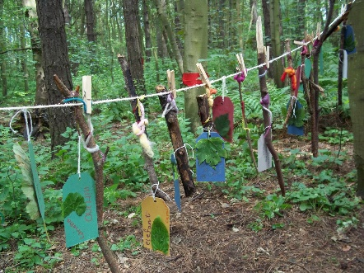
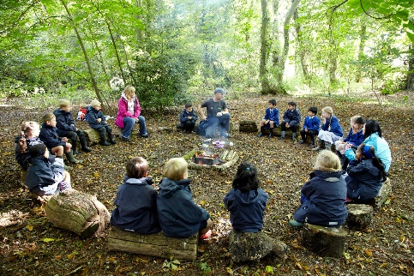
FOREST SCHOOL…..
CREATIVE, RISK TAKING, CO-OPERATIVE, NEW EXPERIENCES, INDEPENDENCE, NEW FRIENDSHIPS
Your child will need to come to school in their forest school kit and bring clean uniform and shoes to change into after.
These sessions are led by specialist forest school leader Mr Fox

Slide 7
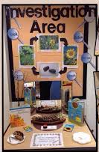
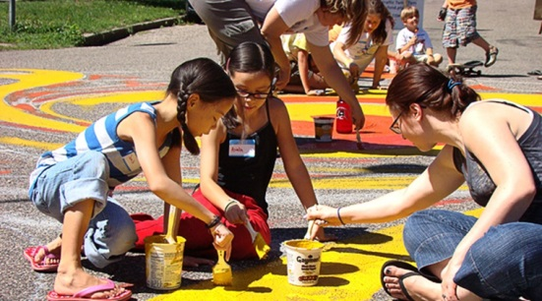
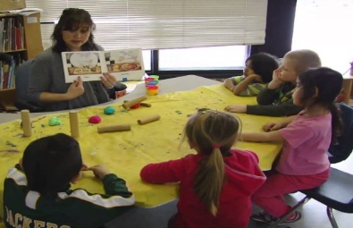
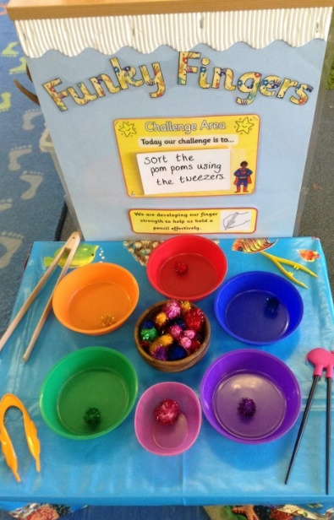
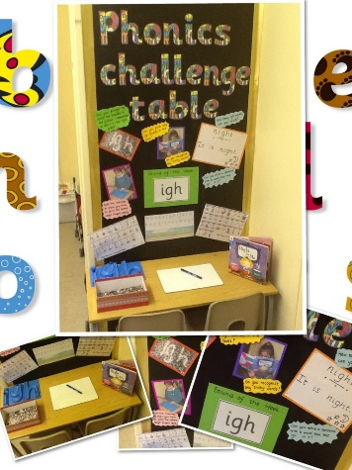
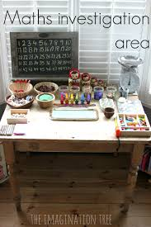
How do we deliver the curriculum?
Adult led
‘Enabling environment activities’
themed and differentiated through adult interaction
and questioning
Challenges- linked to writing, maths
and phonics.
Writing evidence recorded in writing journal,
Evidence Me used to record wow moments.
Please give your email address so these wow moments can be shared with you.

Slide 8



In school we use the online package ‘2simple- evidence me’ to record evidence of Continuous Provision activities
‘Parent Share’ package available
This allows parents to view the observations we have made of your child at home, including photographs, with a short description of the activity or outcome and the area of learning it relates to.
Through parent share you can also make contributions to your child’s learning journey by sending in photographs of the things your child has achieved at home.
Please note you can not communicate with the teacher
regarding general enquiries through parent share.

Slide 9
Here’s how!
Provide your preferred email address to school (via 2simple letter)
Accept the invite that will be emailed to your given address
‘observations’ will be emailed to you.
Contribute to your child’s learning journey.

Slide 10
