Slide 1
Phonics and Reading Reception Parent Meeting
(Sept 2022)

Slide 2
What is Phonics?
Phonics is a method of learning to read. Phonics works by breaking each word up into it’s individual sounds before blending those sounds back together to make the word. Children learn to 'decode' words by breaking it down into sounds rather than having to memorise 1,000's of words individually.

Slide 3
Phase 1 in Phonics is not about learning the sounds with flashcards, it is about getting ready to learn the sounds. It is primarily speaking and listening activities.
The emphasis during Phase 1 is to get children attuned to the sounds around them and ready to begin developing oral blending and segmenting skills.
Being secure in Phase 1 is vital to future success in phonics.
It is split into 7 aspects-
*General sound discrimination- environmental, instrumental and body
*Rhyme
*Alliteration
*Voice sounds
*Oral blending
It is really good fun!

Slide 4
How can I help at home?
Play ‘I spy’ with sounds not the alphabet names
Sing lots of nursery rhymes
Choses stories that use alliteration
Play pairs with words and pictures
Play sound bingo games
Play lots of party games like Musical statues
Read lots of rhyming books
Play the shopping bag game
Rhyming cards

Slide 5
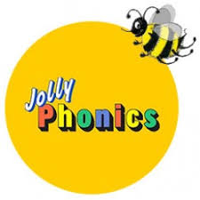
Jolly Phonics

Slide 6
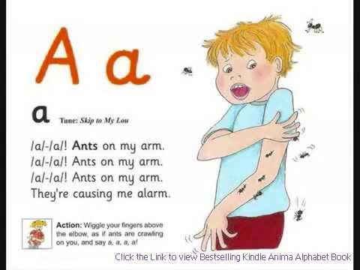
Jolly Phonics
Kinaesthetic and ‘fun’ approach to learning letter sounds.
Each sound has a ‘jolly jingle’ and an action
https://www.youtube.com/watch?v=QqnqwzqWAHk

Slide 7
Sounds Write
Our Phonics Programme

Slide 8
Why Sounds Write?
Sounds write is a systematic phonics programme that runs from EYFS to Y2 and beyond (if needed).
It teaches the three essential skills of segmenting, blending and phoneme manipulation needed for reading and spelling on a daily basis until all children achieve the automaticity that underlines the fluency of every successful reader.

Slide 9
What is Sounds Write?
A phonics programme which focuses on pure sound and encourages blending and segmenting of words from the very beginning.
No sound is taught in isolation – children learn a number of sounds at the same time:
e.g. a i m s t
Children will then build words using these sounds by listening, repeating and writing in every session.
am, at, as, sam, sat, sit, pat, pam, pit

Slide 10
The Initial Code
The ‘code’ refers to the sounds children are taught. Once they understand the code, they are able to read and write it!
Sounds are not taught in alphabetical order. The initial code works through the phonemes (sounds) in an order which enables them to build words as they go, and build on skills as well.
They are encouraged to “say the sounds” then “read the word”
e.g. s - i - t = sit
f – l – i – ck = flick

Slide 11
Skills | Code
cvc | a, i, m, s, t
 | n, o, p
 | b, c, g, h
 | d, e, f, v
 | k, l, r, u
 | j, w, z
 | x, y, ff, ll, ss, zz
vcc (ink) cvcc (jump) | no new code
ccvc (frog) | no new code
ccvcc (stink) cccvc (scrub) | no new code
 | sh, ch, th, ck, wh, ng, qu

Slide 12
The Initial Code Activities
The Sounds Write approach introduces a series of structured and repetitive lessons that introduce key skills to read and write. The lessons are repeated for each letter set within the code.
Throughout the phonics sessions children will learn to:
Build words
Search for sounds
Swap Sounds in words
Read and spell words

Slide 13
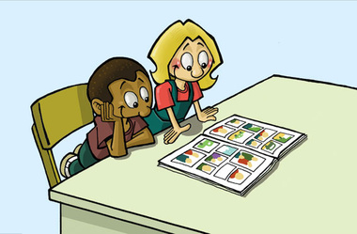
The Extended Code
In the extended code, children are taught that :
Many spellings represent more than one sound.
Many sounds can be represented by more than one spelling.
E.g.
/ae/ can be spelt
ay (play) ai (drain) ea (great) a-e (gate)

Slide 14
The Extended Code
Within the extended code the children explore;
Word building
Sound sorting (Reading/Writing)
Sound spotting (Reading/Writing)
Sentence writing

Slide 15
Home Readers
Your child will come home with two reading books. One which matches your child’s current phonics sound and one which is a book banded reading scheme book.
Children who have lilac (a picture book to discuss with you) pink, red or yellow books will be asked to read their book at least 3 times before it is changed; two or more times at home and once in school with their class teacher or teaching assistant. This is to develop children’s fluency and their comprehension skills. Please also discuss the stories and ask your child about what they have read.

Slide 16
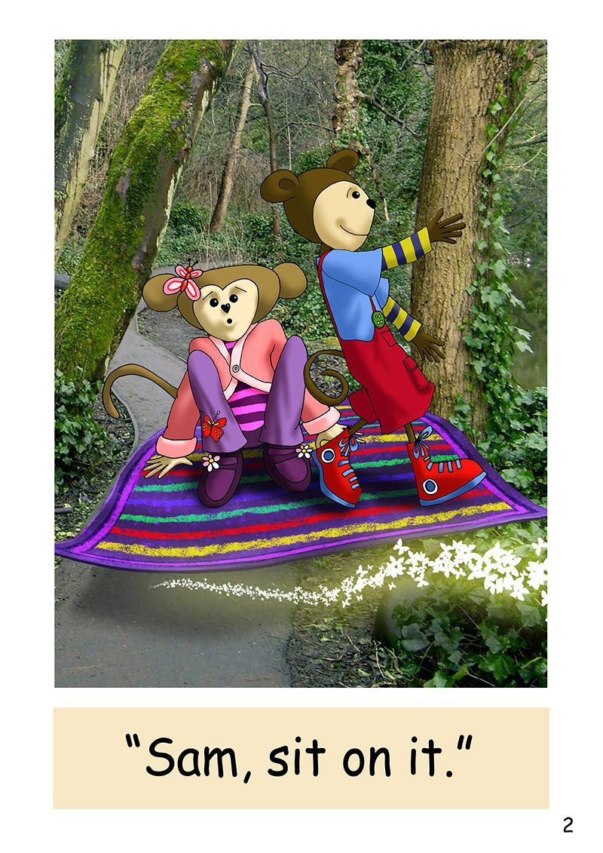
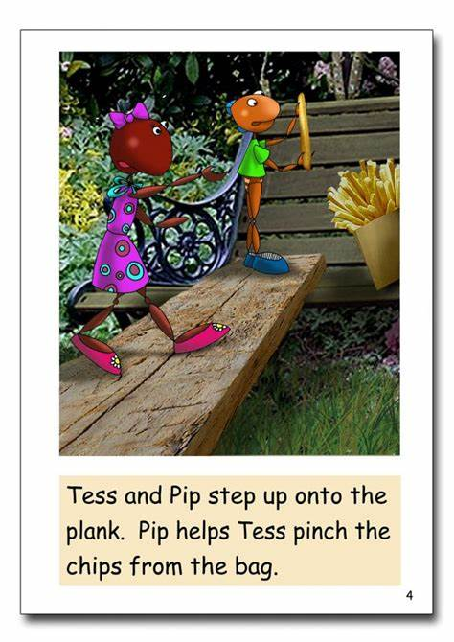
Segmenting and Blending
Segmenting in phonics is the ability to separate a word into its sounds. The sounds are called phonemes, the units of sound that make up language. To segment the word ‘sit’ you would split it into its three phonemes, s- i- t. Blending in phonics is combining these broken down sounds to make the word.

Slide 17
Helping your child to share books and read at home
‘Walk through’ – talk about pictures
Sound out words and blend together to read
You as the adult need to model this process.
Re-read sentence to make sure it makes sense.
Talk about the story together to
Make sure your child understands it.
Ask, which was their favourite part?
Are there any parts they did not like?
Can they relate it to their own
experience?
PLEASE WRITE IN PLANNER WHEN YOU HAVE HEARD YOUR CHILD READ (at least 4x a week) AND FEEL FREE TO COMMENT ON YOUR CHILD’S ENJOYMENT OF THE BOOK.

Slide 18
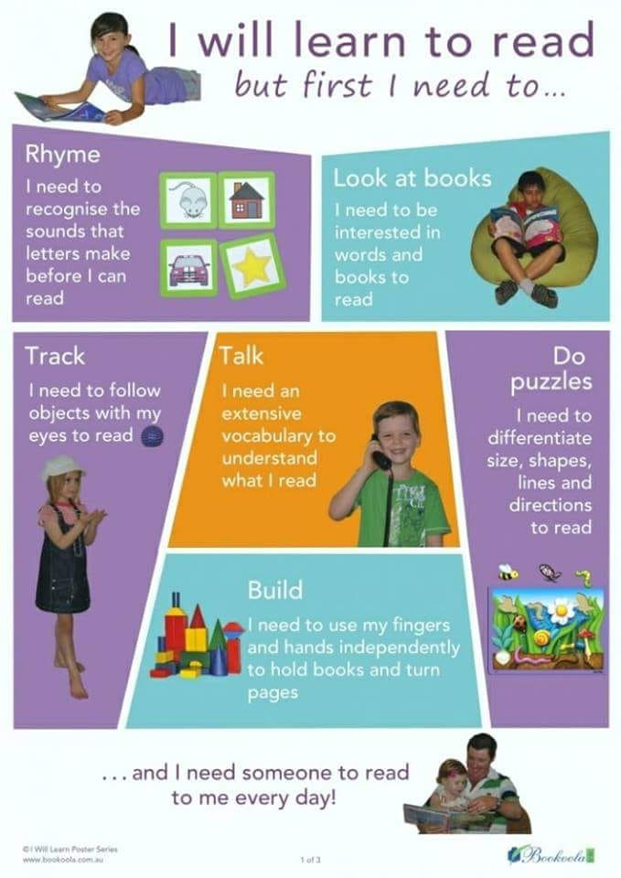

Slide 19
Remember….
“The more that you read, the more things you will know. The more that you learn, the more places you'll go.”
Dr. Seuss, I Can Read With My Eyes Shut!

Slide 20
Any Questions?

