Slide 1
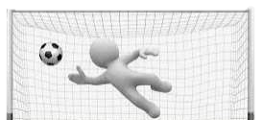
Unit plan
Individual, sequential component lessons (football) build throughout the unit and are applied regularly to the building composite final piece / game/ sequence (goal).
Fluent components are applied into sequences, games and competitive settings where children can be self and peer evaluative to allow them to become autonomous
Key skills become fluent through compositional devices and tactics being introduced (component)
Prior learning – find out what the children do or don’t already know/ gaps in learning from the year previously and current year to ensure appropriate components are positioned to make subsequent learning possible.
Key skills are taught and built up upon (component)

Slide 2
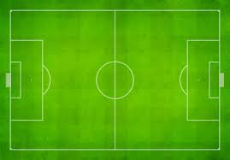
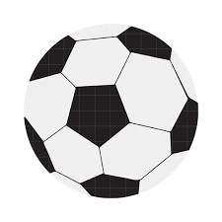
Physical Education Lesson Pathway
Warm up
(revisit and retrieve knowledge and vocabulary from previous taught components to improve automaticity and make connection to scene)
Evaluate and reflect on the new component linking back to the LO.
Share specific
LO (new component), mantra and context to the lesson and how it links to previous components
AFL and
Questioning throughout
Apply and master component by combining it with previously taught components in a slowly built up composite
Introduce new vocabulary and use in context
Model and teach new component, linking new vocabulary and use scaffolding learning when needed
Practise and repeat new component to ensure fluency.
Throughout the lesson- 80% active, evaluate their own and other people’s performances, PE vocabulary to be used throughout the lesson.

