Slide 1
Year 4 Multiplication Tables Check

Slide 2
Important information about multiplication tables check (MTC)
The MTC determines if Year 4 children can fluently recall their multiplication tables.
They are deigned to help schools identify which children require more support to learn their times tables.
There is no ‘pass’ rate or threshold which means that, unlike the Phonics Screening Check, children will not be expected to re-sit the check.
The Department for Education (DfE) will create a report about the overall results across all schools in England, not individual schools.

Slide 3
When the check will take place
There will be a 2 week window from Monday 2nd June 2025 for schools to administer the check.
There is no set day to administer the check and children are not expected to take the check at the same time.
All eligible Year 4 children in England will be required to take the check.

Slide 4
How the check is carried out
The check will be fully digital.
Answers will be entered using a keyboard, by pressing digits using a mouse or using an on-screen number pad.
Usually, the check will take less than 5 minutes for each child.
The children will have 6 seconds from the time the question appears to input their answer.
There will be a total of 25 questions with a 3 second pause in-between questions.
There will be 3 practice questions before the check begins.

Slide 5
Specific arrangements for the check
Some children will be eligible for specific arrangements:
Colour contrast;
Font size adjustment;
‘Next’ button (alternative to 3-second pause);
Removing on-screen number pad;
An adult to input answers;
Audio version;
Audible time alert.

Slide 6
The check questions
Each child will be randomly assigned a set of questions
There will only be multiplication questions in the check, not division facts.
The 6, 7, 8, 9 and 12 times tables are more likely to be asked.
Reversal of questions (e.g. 8 x 6 and 6 x 8) will not be asked in the same check.
Children will not see their individual results when they complete the check.

Slide 7
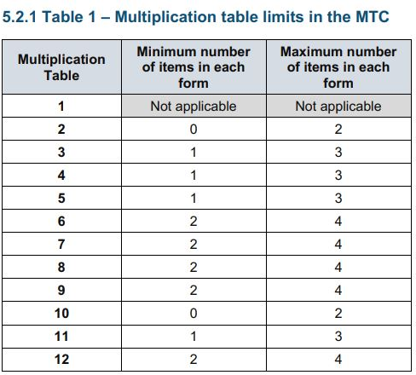
More information about the questions
The Standards and Testing Agency (STA) state that they are classifying the multiplication tables by the first number in the question. For example, 8 x 3 would fall within the 8 times table.

Slide 8
Ways to support times table knowledge
Count and look for patterns.
Understand that multiplication is repeated addition.
Remember that multiplication is commutative.
Remember that multiplication is the inverse of division.
Recall and utilise number families.
Use different representations to represent multiplication, such as:
Concrete manipulatives suck as multilink cubes or counters.
Create pictorial representations such as arrays.

Slide 9
Counting and looking for patterns.
Example: Counting in 2s
2, 4, 6, 8, 10…
Ensure children have a strong understanding of counting in groups first.
When children are secure with counting, they can then look for patterns.

Slide 10
Repeated addition
Knowing that 2 x 4 is the same as 2 + 2 + 2 + 2
2 + 2 + 2 + 2 = ?
2 x 4 = ?
Notes:
Children need experience of using concrete manipulatives such as counters or multilink cubes and pictorial representations of objects, forming arrays.

Slide 11
Multiplication is commutative
3 x 2 is the same as 2 x 3
Children need to understand that multiplication can be completed in any order to produce the same answer. Sometimes this link needs to be made explicit.
3 lots of 2 = 6
2 lots of 3 = 6

Slide 12
Multiplication is the inverse of division
20 ÷ 5 = 4 can be worked out because 5 x 4 = 20
Using pictorial representations (such as arrays) is useful here for children to see the link between multiplication and division.

Slide 13
Number families
4 x 5 = 20, 5 x 4 = 20, 20 ÷ 5 = 4, 20 ÷ 4 = 5
Due to their commutative understanding, children should also be able to see whole number families. For many children this will need to be pointed out and discussed.
20
4
5

Slide 14
Using known facts
4 x 6 = ?
I know 4 x 5 = 20
Therefore, 20 + 4 = 24
By using known facts from ‘easier’ times tables, children should be able to find answers with increasing speed.
+

