Slide 1
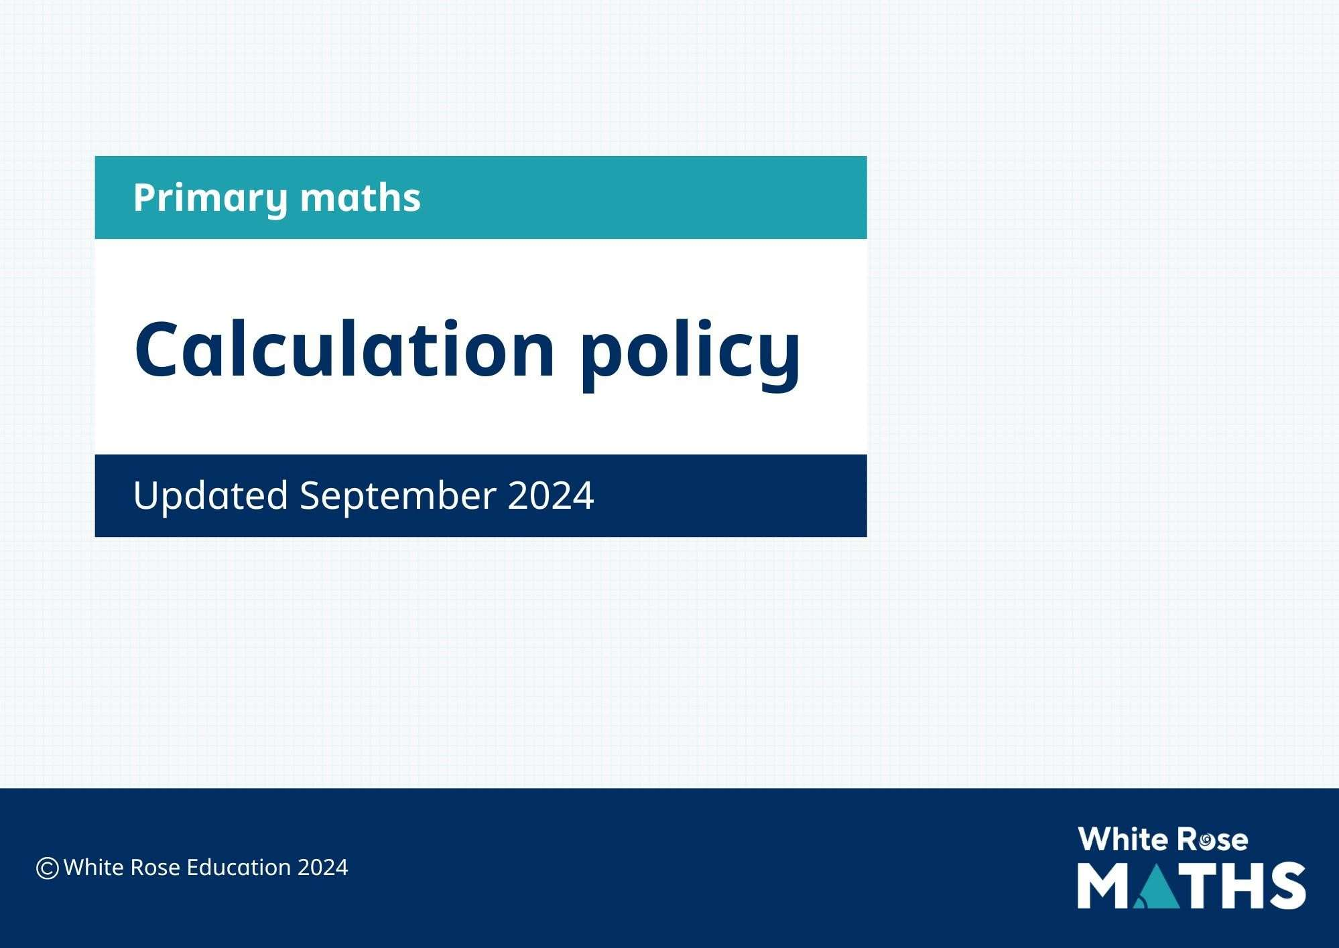

Primary schemes of learning
©White Rose Education 2024

Slide 2

Progression of skills - Addition
Year group | Skill
Nursery | Subitise to 3 Count how many Make numbers to 5 Add 1 more (through songs and rhymes)
Reception | Conceptually subitise to 5 1 more Notice the composition of numbers within 10 Combine 2 groups Add more
Year 1 | Add together Add more Bonds within 10 Related facts within 20 Missing numbers

Slide 3
Progression of skills - Addition
Year group | Skill
Year 2 | Add 1s to any number (related facts) Add three 1-digit numbers Add across a 10 Add multiples of 10 Add 10s to any number Add two 2-digit numbers (not across a ten) Add two 2-digit numbers (across a ten) Missing numbers
Year 3 | Add 1s, 10s and 100s to a 3-digit number Add two numbers (no exchange) Add two numbers across a 10 or 100 Complements to 100 Add fractions with the same denominator within 1 whole Calculate the duration of events

Slide 4
Progression of skills - Addition
Year group | Skill
Year 4 | Add 1s, 10s and 100s to a 4-digit number Add up to two 4-digit numbers Add decimal numbers in the context of money Add fractions and mixed numbers with the same denominator beyond 1 whole

Slide 5
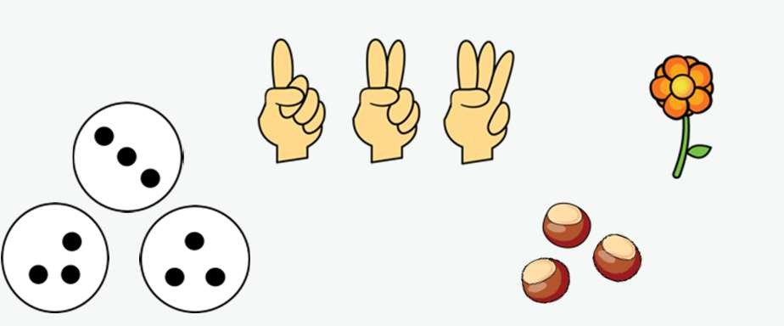
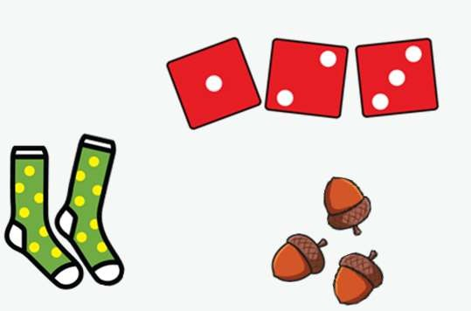



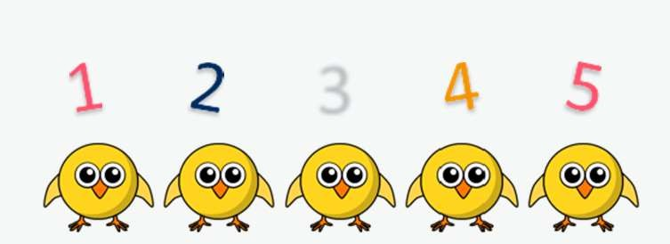

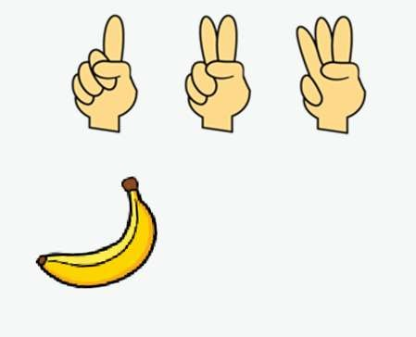
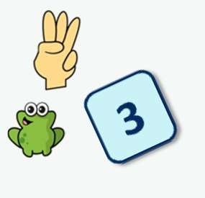
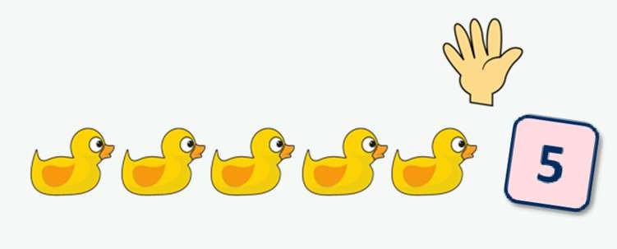




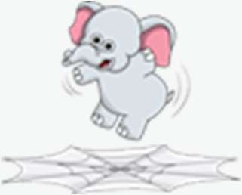
Addition
Nursery | Begin to have an understanding of numbers to 5 We recommend focusing on noticing and representing small quantities, perceptual subitising and counting.
Progression of skills | Key representations
Subitise to 3 Instantly see how many. | How many do you see?
Count how many Begin to count objects using 1-1 correspondence. | How many are there? 3 | Count out … from a larger group. E.g. Collect 3 beanbags for a game.
Make numbers to 5 Start by showing 1, 2 and 3 using fingers. | Show me… | Begin to link numerals to quantities.
Add 1 more Through stories, songs and rhymes. | How many do I have now?

Slide 6

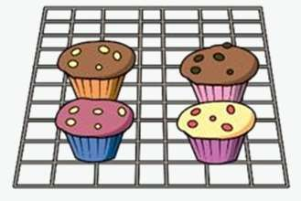






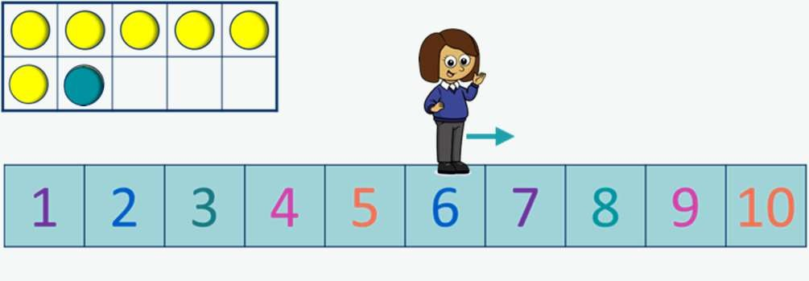
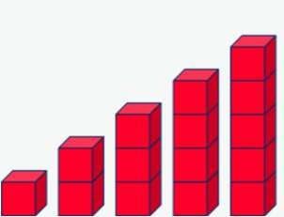




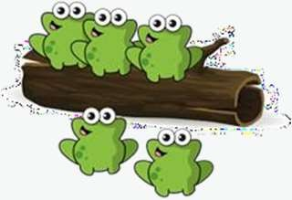
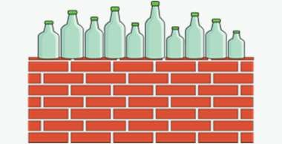
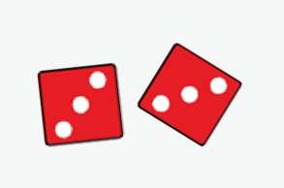


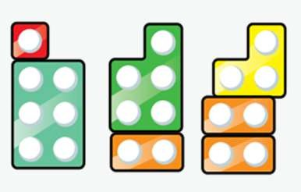
Addition
Reception | Have a deep understanding of numbers to 10, including the composition of each number. Subitise (recognise quantities without counting) up to 5 Automatically recall (without reference to rhymes, counting or other aids) number bonds up to 5 and some number bonds to 10, including double facts.
Progression of skills | Key representations
Conceptually subitise to 5 Notice the parts that make up the whole. | What do you see? How do you see it?
1 more Continue to link to stories, songs and rhymes. | 1 more than … is …
Notice the composition of numbers within 10 Link to stories, songs and rhymes. | How many…? How many…? How many altogether? | How many ways can you make…?

Slide 7
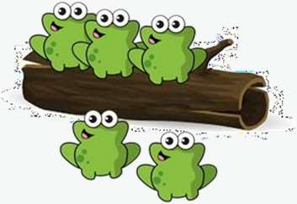


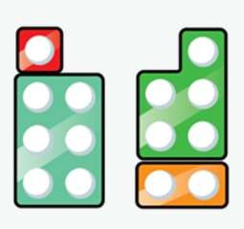
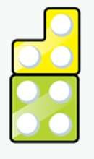
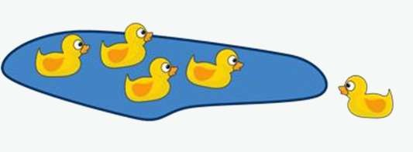

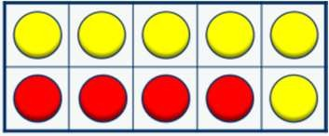





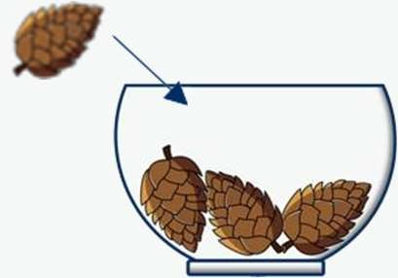

Addition
Progression of skills | Key representations
Combine 2 groups 2 groups are combined to find the total. | There are …. There are …. There are …. altogether. | …. and …. make ….
Add more A quantity is increased. | First… Then…. Now…. | I have …. I add …. more. Now I have….

Slide 8

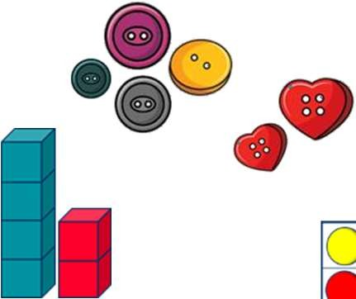
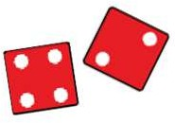
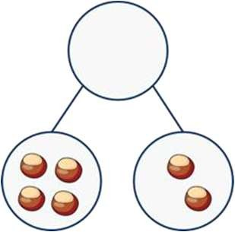
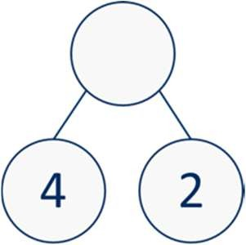
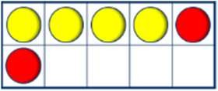
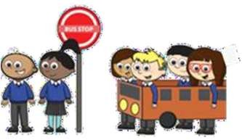
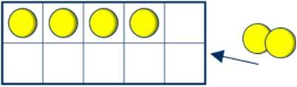

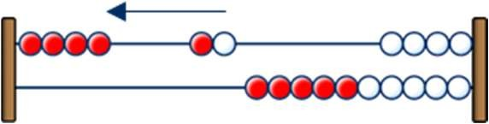
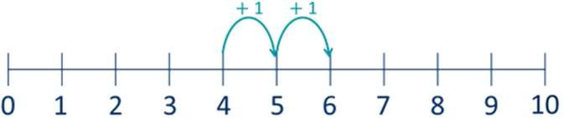
Addition
Year 1 | Read, write and interpret mathematical statements involving addition (+) and equals (=) signs. Represent and use number bonds within 20 Add 1-digit and 2-digit numbers to 20, including zero. Solve one-step problems that involve addition, using concrete objects and pictorial representations, and missing number problems such as 7 = + 2
Progression of skills | Key representations
Add together (aggregation) 2 quantities are combined to find the total. | There are … There are … There are … altogether. | … is a part. … is a part. … is the whole. | ... plus … is equal to … … is equal to …. + … 4 + 2 = 6 2 + 4 = 6 6 = 4 + 2 6 = 2 + 4
Add more (augmentation) A quantity is increased. | First… Then… Now… | I start at … I jump on … I land on … | … plus … is equal to … is equal to … + … 4 + 2 = 6 2 + 4 = 6 6 = 4 + 2 6 = 2 + 4

Slide 9
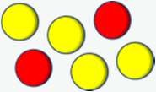
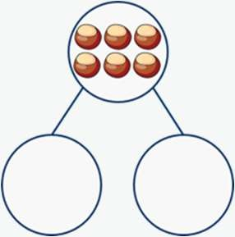
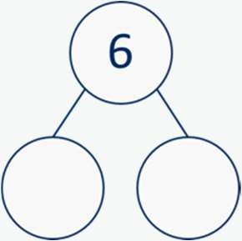
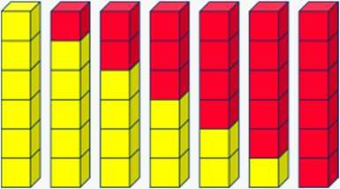
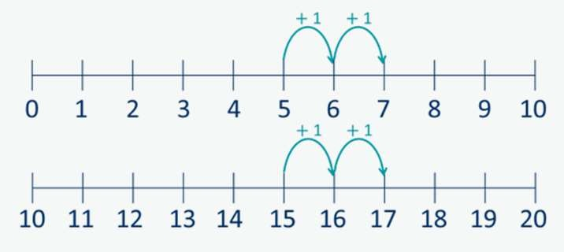
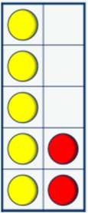
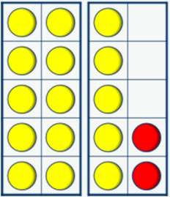
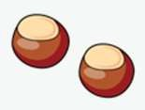


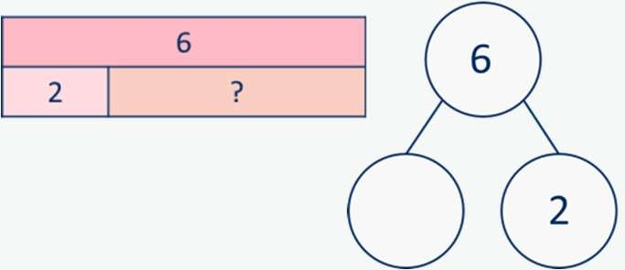
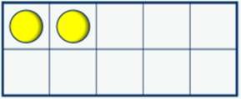
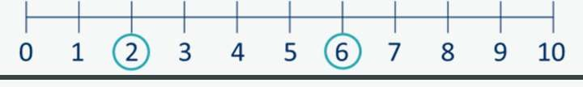
Addition
Progression of skills | Key representations
Bonds within 10 Include bonds for each number within 10 Encourage children to notice patterns. | … is made of … and … … and … make … | … can be partitioned into … and … | … plus … is equal to … 6 + 0 = 6 5 + 1 = 6 4 + 2 = 6 3 + 3 = 6 2 + 4 = 6 1 + 5 = 6 0 + 6 = 6
Related facts within 20 Make links to known facts. | I know that … and ... = … so … and … = ... | … more than … is … so … more than … is … | What patterns do you notice? 5 + 2 = 7 15 + 2 = 17 7 = 5 + 2 17 = 15 + 2
Missing numbers Make links to known facts. | How many more do you need to make …? | If … is the whole and … is a part, the other part must be… | … plus … is equal to … 2 + = 6 6 = 2 +

Slide 10
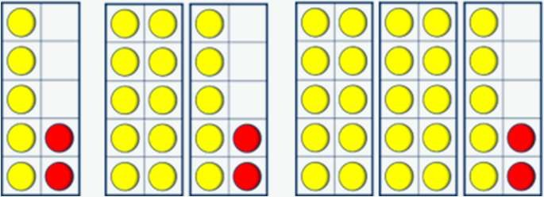


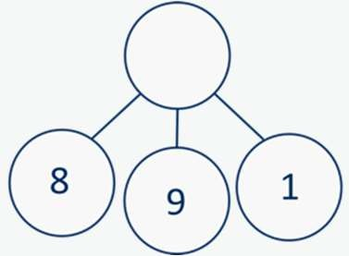
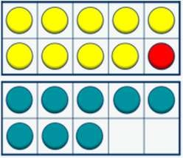
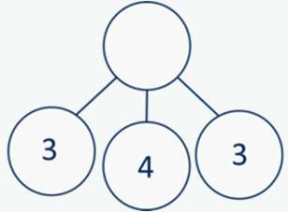
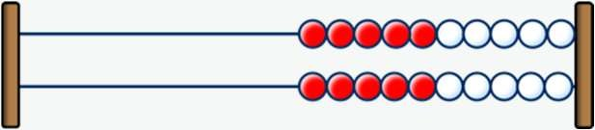
Addition
Year 2 | Recall and use addition facts to 20 fluently, and derive and use related facts up to 100 Add numbers using concrete objects, pictorial representations, and mentally, including: a two-digit number and 1s a two-digit number and 10s 2 two-digit numbers adding 3 one-digit numbers Recognise and use the inverse relationship between addition and subtraction and use this to check calculations and solve missing number problems.
Progression of skills | Key representations
Add ones to any number (related facts) Make links to known facts. | I know that … and ... = … so … and … = ... | … more than … is … so … more than … is … + 1 + 1 0 1 2 3 4 5 6 7 8 9 10 + 1 + 1 20 21 22 23 24 25 26 27 28 29 30 | What do you notice? Can you continue the pattern? 5 + 2 = 7 15 + 2 = 17 25 + 2 = 27…
Add three 1-digit numbers Prompt children to understand that addition can be done in any order and to make links to known facts. | … and … are a bond to 10 10 + … = … | Double … + … = … | What do you notice? Which addition is the easiest to calculate? 8 + 9 + 1 = 8 + 1 + 9 = 9 + 1 + 8 =
?
4 | 3 | 3

Slide 11
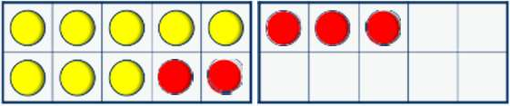
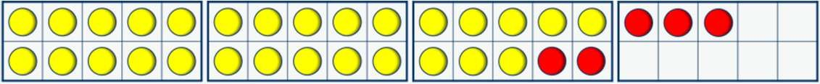
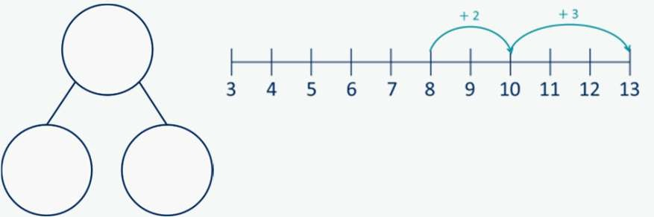
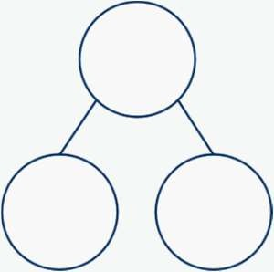





Addition
Progression of skills | Key representations
Add across a 10 | … can be partitioned into … and … 8 + 5 2 3 |  | I add … to get to … then I add … |  | 8 + 5 = 13
 |  |  |  |  | 28 + 5 = 33
Partition the number being added to make a full ten.
 |  |  | 28 + 5
 |  |  | 2 3
Add multiples of 10 Make links to known facts within ten. | … ones + … ones = … ones so … tens + … tens = … tens 3 + 2 = 5 30 + 20 = 50 | What is the same? What is different?
Add 10s to any number Make links to known facts. | … tens + … tens = … tens … tens and … ones = … | To add … I need to add 10 … times. |  | I know that … and ... = … so … and … = ... 30 + 20 = 50 34 + 20 = 54

Slide 12










Addition
Progression of skills | Key representations
Add 2-digit numbers (not across a ten) Lining up ones and tens in columns will support with later written methods. | … ones + … ones = … ones _{3 ones + 1 one = 4 ones} … tens + … tens = … tens _{4 tens + 2 tens = 6 tens} 6 tens + 4 ones = 64
Add 2-digit numbers (across a ten) Begin to exchange 10 ones for 1 ten. | There are …. ones, so I do/do not need to make an exchange. … ones = … ten and … ones 5 ones + 7 ones = 12 ones 12 ones = 1 ten and 2 ones 4 tens + 3 tens + 1 ten = 8 tens 8 tens and 2 ones = 82
Missing numbers Solve missing number problems and use the inverse to check. | How many more do you need to make …? 6 + = 10 10 − = 6 | If … is a whole and … is a part, then … is the other part. + 3 = 7 7 − 3 = | … can be partitioned into … and … 10 + 8 = 12 +
?
45 | 37

Slide 13




Addition
Year 3 | Add numbers mentally, including: a three-digit number and ones, a three-digit number and tens, a three-digit number and hundreds. Add numbers with up to three digits, using formal written methods of columnar addition. Add fractions with the same denominator within 1 whole. Calculate the time taken by particular events or tasks.
Progression of skills | Key representations
Add 1s, 10s or 100s to a | The ones/tens/hundreds column will increase by … 444 + 5 = 777 + 2 = 444 + 50 = 777 + 20 = 444 + 500 = 777 + 200 = | What patterns do you notice?
3-digit number
 |  | 235 + 3 =
Emphasis on mental |  | 235 + 30 =
strategies including number |  | 235 + 300 =
 |  | 604 + 20 = 604 + 50 = 604 + 90 = | 111 + 111 + 111 +
bonds and related facts. |  |  |  |  | = 118
Prompt children to notice which digit changes. |  |  |  |  | = 181 = 811
Add two numbers (no exchange) | ... ones + … ones = … ones ... tens + … tens = … tens ... hundreds + … hundreds = … hundreds
Mental strategies and introduction of formal written method.

Slide 14







Addition
Progression of skills | Key representations
Add two numbers across a 10 or 100 Formal written method involving up to 2 exchanges including 3-digit plus 2-digit numbers. | There are … ones, so I do/do not need to make an exchange. There are … tens, so I do/do not need to make an exchange. … ones = … ten and … ones. … tens = … hundred and … tens.
Complements to 100 | … plus … is equal to 100 | I add … to get to the next 10, then ... to get to
Pairs of numbers which total 100 |  | 100 38 + 62 = 100 62 + 38 = 100 100 = 38 + 62 100 = 62 + 38

Slide 15








Addition
Progression of skills | Key representations
Add fractions with the same denominator within 1 whole Make links with known facts. | When adding fractions with the same denominator, I only add the numerator. … fifths + … fifths = … fifths
Calculate the duration of events Find durations of time between a given start and end point. Children will need to calculate complements to 60 | From … to … o’clock is … minutes. From … o’clock to … is … minutes. The total time taken is … minutes.

Slide 16


Addition
Year 4 | Add numbers with up to 4 digits using a formal written method. Solve simple measure and money problems involving fractions and decimals to 2 decimal places. Add fractions with the same denominator.
Progression of skills | Key representations
Add 1s, 10s and 100s to a | The ones/tens/hundreds/thousands column will increase by … 3,425 + 3 = 3,425 + 300 = 3,425 + 30 = 3,425 + 3,000 = | What patterns do you notice? 2,350 + 3 = 2,350 + 30 = 2,350 + 300 = 2,350 + 3,000 = 6,040 + 200 = ^{2,211 +} 6,040 + 500 = 2,211 + 6,040 + 900 = 2,211 + | = 2,251 = 2,215 = 2,511
4-digit number
Emphasis on mental
strategies including number
bonds and related facts.
Prompt children to notice
which digit changes.
Add up to two 4-digit numbers | There are … ones/tens/hundreds so I do/do not need to make an exchange.
Formal written method with up to 3 exchanges. Encourage children to estimate and use inverse operations to check answers to calculations. | I can exchange 10 … for 1 …

Slide 17







Addition
Progression of skills | Key representations
Add decimal numbers in the context of money | … pence + … pence = … pence … pounds + … pounds = … pounds | £3.25 can be partitioned into £3 + 20p + 5p
Emphasis on partitioning and use of number lines rather than formal written calculations. | 45p + 25p = 70p £2 + £3 = £5 £5 + 70p = £5.70
Add fractions and mixed | When adding fractions with the same denominator, I only add the numerator.
numbers with the same | … fifths + … fifths = … fifths
denominator beyond 1 whole

Slide 18
Progression of skills - Subtraction
Year group | Skill
Nursery | Subitise to 3 Count how many Make numbers to 5 Take 1 away (through songs and rhymes)
Reception | Conceptually subitise to 5 1 less Notice the composition of numbers within 10 Partition Take away
Year 1 | Find a part Take away Bonds within 10 Related facts within 20 Missing numbers

Slide 19
Progression of skills - Subtraction
Year group | Skill
Year 2 | Subtract 1s from any number (related facts) Subtract across a 10 Subtract multiples of 10 Subtract 10s from any number Subtract two 2-digit numbers (not across a ten) Subtract two 2-digit numbers (across a ten) Missing numbers
Year 3 | Subtract 1s, 10s and 100s from a 3-digit number Subtract two numbers (no exchange) Subtract two numbers across a 10 or 100 Complements to 100 Subtract fractions with the same denominator within 1 whole

Slide 20
Progression of skills - Subtraction
Year group | Skill
Year 4 | Subtract 1s, 10s, 100s and 1,000s from a 4-digit number Subtract up to two 4-digit numbers Subtract decimal numbers in the context of money Subtract fractions and mixed numbers with the same denominator

Slide 21














Subtraction
Nursery | Begin to have an understanding of numbers to 5 We recommend focusing on noticing and representing small quantities, perceptual subitising and counting.
Progression of skills | Key representations
Subitise to 3 Instantly see how many. | How many do you see?
Count how many Begin to count objects using 1-1 correspondence. | How many are there? 3 | Count out … from a larger group. E.g. Collect a cup for everyone at the table.
Make numbers to 5 Start by showing 1, 2 and 3 using fingers. | Show me… | Begin to link numerals to quantities.
Take 1 away Through stories, songs and rhymes. | How many do we have now?

Slide 22



















Subtraction
Reception | Have a deep understanding of number to 10, including the composition of each number. Subitise (recognise quantities without counting) up to 5 Automatically recall (without reference to rhymes, counting or other aids) number bonds up to 5 (and some subtraction facts) and some number bonds to 10, including double facts.
Progression of skills | Key representations
Conceptually subitise to 5 Notice the parts that make up the whole. | What do you see? How do you see it?
1 less Continue to link to stories, songs and rhymes. | 1 less than … is …
Notice the composition of numbers within 10 Link to stories, songs and rhymes. | How many…? How many…? How many altogether? | How many ways can you make…?

Slide 23













Subtraction
Progression of skills | Key representations
Partition Using objects, explore different ways to partition a number into 2 or more parts. | There are … altogether. I can see … here and … there. | … and … make …
Take away A quantity is reduced. | First… Then… Now… | I have … I take … away Now I have …

Slide 24










Subtraction
Year 1 | Read, write and interpret mathematical statements involving subtraction (–) and equals (=) signs. Represent and use number bonds and related subtraction facts within 20 Subtract one-digit and two-digit numbers to 20, including zero. Solve one-step problems that involve subtraction, using concrete objects and pictorial representations, and missing number problems such as 7 = 9
Progression of skills | Key representations
Find a part Link to number bonds and known facts. E.g. 2 + 4 = 6 so if 6 is the whole and 4 is a part, the other part must be 2 | There are … in total. … are … How many are not …? | … is the whole. … is a part. … is a part. 6 6 4 | … subtract … is equal to … … is equal to … − … 6 − 2 = 4 6 − 4 = 2 4 = 6 − 2 2 = 6 − 4
Take away A quantity is decreased. | First… Then… Now… | I start at … I jump back … I land on … − 1 −1 0 1 2 3 4 5 6 7 8 9 10 | … minus … is equal to … … is equal to … − … 6 − 2 = 4 6 − 4 = 2 4 = 6 − 2 2 = 6 − 4
1 | 2 | 3 | 4 | 5 | 6 | 7 | 8 | 9 | 10

Slide 25










Subtraction
Progression of skills | Key representations
Bonds within 10 | … is made of … and … | … can be partitioned into … | … minus … is equal to …
Focus on subtraction facts. Encourage children to notice patterns. | … and … make … | and … | 6 − 0 = 6 6 − 1 = 5 6 − 2 = 4 6 − 3 = 3 6 − 4 = 2 6 − 5 = 1 6 − 6 = 0
Related facts within 20 | I know that … minus ... = … | … less than … is … | What patterns do you
 | so … minus … = ... | so … less than … is … | notice?
Make links to known facts. |  | −1 − 1 − 1 0 1 2 3 4 5 6 7 8 9 10 −1 − 1 − 1 10 11 12 13 14 15 16 17 18 19 20 | 8 − 3 = 5 18 − 3 = 15 5 = 8 − 3 15 = 18 − 3
Missing numbers Make links to known facts. | How many do you need to subtract to make …? | If … is the whole and … is a part, the other part must be… | … minus … is equal to … 6 − = 2 2 = 6 −

Slide 26














Subtraction
 | Recall and use subtraction facts to 20 fluently, and derive and use related facts up to 100 Subtract numbers using concrete objects, pictorial representations, and mentally, including: a two-digit number and 1s a two-digit number and 10s 2 two-digit numbers Recognise and use the inverse relationship between addition and subtraction and use this to check calculations and solve missing number problems.
Progression of skills | Key representations
Subtract ones from any | I know that … minus ... = … | … less than … is … |  |  |  |  |  |  |  |  | What do you notice?
number | so … minus … = ... | so … less than … is … |  |  |  |  |  |  |  |  | Can you continue the
(related facts) Make links to known facts. |  | 0 1 20 21 | 2 22 | 3 23 |  | 4 24 | 5 25 | −1 − 1 − 1 6 7 8 −1 − 1 − 1 26 27 28 | 9 29 | 10 30 | pattern? 8 − 3 = 5 18 − 3 = 15 28 − 3 = 25…
Subtract across a 10 | … can be partitioned into … and … − 2 − 3 13 − 5 3 4 5 6 7 8 9 10 11 12 13 3 2 |  |  |  | Make links with related facts.
Partition the number being
subtracted to bridge |  |  |  |  |  |  |  |  |  |  |  |  |  |  |  |  | − 2 |  | − 3
through a ten. |  |  |  |  | 33 − 5
 |  |  |  |  |  |  |  |  |  |  | 3 | 4 | 5 | 6 | 7 | 8 | 9 | 10 | 11 12 | 13
 |  |  |  |  |  |  |  |  |  |  |  |  |  |  |  |  | − 2 |  | − 3
 |  |  |  |  |  |  |  | 3 | 2
 |  |  |  |  |  |  |  |  |  |  | 23 | 24 | 25 | 26 | 27 | 28 | 29 | 30 | 31 32 | 33

Slide 27





Subtraction
Progression of skills | Key representations
Subtract multiples of 10 | … ones − … ones = … ones so … tens − … tens = … tens 5 − 2 = 3 50 − 20 = 30 | What is the same? What is different? − 2 |  |  |  |  |  | 5 | 2 | 50 | 20
Make links to known facts
within ten.
 |  | 0 1 2 3 4 5 6 | 7 | 8 | 9 |  | 10 |  | 5
 |  |  |  |  |  |  |  |  | 2 | ?
 |  | − 2
 |  |  |  |  |  |  |  |  | 50
 |  | 0 10 20 30 40 50 60 | 70 | 80 | 90 |  | 100 |  | 20 | ?
Subtract 10s from any number Make links to known facts. | … tens − … tens = … tens … tens and … ones = … | To subtract … I need to subtract 10 … times. |  |  |  | I know that … minus ... = … so … minus … = ... 50 − 20 = 30 54 − 20 = 34

Slide 28















Subtraction
Progression of skills | Key representations
Subtract two 2-digit numbers (not across a ten) | … ones − … ones = … ones … tens − … tens = … tens 43 3 ones − 1 one = 2 ones ₂₁ 4 tens − 2 tens = 2 tens 2 tens and 2 ones = 22
Subtract two 2-digit numbers (across a ten) Begin to exchange 1 ten for 10 ones. | I need to make an exchange because I do not have enough ones to subtract … ones. 43 3 ones − 5 ones 13 ones − 5 ones = 8 ones ²⁵ (I need to exchange 1 ten for 10 ones) 3 tens − 2 tens = 1 ten 1 ten and 8 ones = 18
Missing numbers Solve missing number problems and use the inverse to check. | How many do you need to subtract to make …? 10 − = 6 6 + = 10 | If … is a whole and … is a part, then … is the other part. 7 − 3 = + 3 = 7 | … can be partitioned into … and … 18 − = 12 + 2
43
21 | ?
43
25 | ?
T | O
T | O
T | O

Slide 29




Subtraction
Year 3 | Subtract numbers mentally, including: a three-digit number and ones, a three-digit number and tens, a three-digit number and hundreds. Subtract numbers with up to three digits, using formal written methods. Subtract fractions with the same denominator within 1 whole.
Progression of skills | Key representations
Subtract 1s, 10s and 100s from a 3-digit number Emphasis on mental strategies including number bonds and related facts. Prompt children to notice which digit changes. | The ones/tens/hundreds column will decrease by … 444 − 2 = 777 − 4 = 444 − 20 = 777 − 40 = 444 − 200 = 777 − 400 = | What patterns do you notice? 235 − 3 = 235 − 30 = 235 − 300 = 118 − = 111 ⁶²⁴ ⁻ ²⁰ ⁼ 181 − = 111 654 − 50 = 694 − 90 = ⁸¹¹ ⁻ = 111
Subtract two numbers (no exchange) Mental strategies and introduction of formal written method. | ... ones − … ones = … ones ... tens − … tens = … tens ... hundreds − … hundreds = … hundreds 345 143
769
147 | ?

Slide 30









Subtraction
Progression of skills | Key representations
Subtract two numbers across a 10 or 100 | I need to subtract … ones. I do/do not need to make an exchange. I need to subtract ... tens. I do/do not need to make an exchange. I can exchange 1 … for 10 … |  | 43 | 452
Formal written method involving up to 2 exchanges including 3-digit subtract 2-digit numbers.
Complements to 100 | 100 minus … is equal to … | I subtract … tens, then I subtract … ones.
Focus on subtraction facts. Encourage children to notice patterns. |  | 100 − 38 = 62 100 − 62 = 38 62 = 100 − 38 ⁻ ⁸ ⁻ ³⁰ 38 = 100 − 62 62 70 100

Slide 31





Subtraction
Progression of skills | Key representations
Subtract fractions with the same denominator within 1 whole Make links with known facts. | When subtracting fractions with the same denominator, I only subtract the numerator. … fifths − … fifths = … fifths

Slide 32


Subtraction
Year 4 | Subtract numbers with up to 4 digits using a formal written method. Solve simple measure and money problems involving fractions and decimals to 2 decimal places. Subtract fractions with the same denominator.
Progression of skills | Key representations
Subtract 1s, 10s, 100s and | The ones/tens/hundreds/thousands column will decrease by … 3,425 − 2 = 3,425 − 200 = 3,425 − 20 = 3,425 − 2,000 = | What patterns do you notice?
1,000s from a 4-digit number |  | 4,356 − 3 = 4,356 − 30 =
Emphasis on mental |  | 4,356 − 300 = 4,356 − 3,000 =
strategies including number |  | 4,433 − | = 4,430
bonds and related facts. |  | 6,940 − 200 = _{4,433 −} | = 4,033
Prompt children to notice which digit changes. |  | 6,940 − 300 = 6,940 − 400 = 4,433 − | = 4,403
Subtract up to two 4-digit numbers Formal written method with up to 3 exchanges. Encourage children to estimate and use inverse operations to check answers to calculations. | I need to subtract… ones/tens/hundreds. I do/do not need to make an exchange. I can exchange 1… for 10…

Slide 33







Subtraction
Progression of skills | Key representations
Subtract decimal numbers in the context of money Emphasis here is on partitioning and use of number lines rather than formal written calculations. | I can partition £… into £… and 100p £… − £… = £… 100p − …p = …p £5 − £3.26 ^{£5} £4 − £3 = £1 100p − 26p = 74p _{£4 100p} £5 - £3.26 = £1.74 | £3.26 can be partitioned into £3 + 20p + 6p − 6p − 20p − £3 £1.74 £1.80 £2 £5
Subtract fractions and mixed numbers with the same denominator Include subtracting fractions from wholes. | When subtracting fractions with the same denominator, I only subtract the numerator. … tenths − … tenths = … tenths

Slide 34
Progression of skills - Multiplication
Year group | Skill
Nursery | Continue with counting and subitising skills as a foundation for later work on equal groups. (see addition and subtraction sections)
Reception | Double to 10 Make equal groups
Year 1 | Count in 2s, 5s and 10s Add equal groups Make arrays Make doubles

Slide 35
Progression of skills - Multiplication
Year group | Skill
Year 2 | Link repeated addition and multiplication Use arrays Double The 2 times-table The 10 times-table The 5 times-table Missing numbers
Year 3 | The 3 times-table The 4 times-table The 8 times-table Related facts Multiply a 2-digit number by a 1-digit number - no exchange Multiply a 2-digit number by a 1-digit number - with exchange Scaling Correspondence problems

Slide 36
Progression of skills - Multiplication
Year group Skill
Year 4 | Times-table facts to 12 × 12 Multiply by 1 and 0 Multiply 3 numbers Factor pairs Multiply by 10 and 100 Related facts Mental strategies Multiply a 2 or 3-digit number by a 1-digit number Scaling Correspondence problems

Slide 37














Multiplication
Reception | Have a deep understanding of number to 10, including the composition of each number. Subitise (recognise quantities without counting) up to 5 Automatically recall (without reference to rhymes, counting or other aids) number bonds up to 5 and some number bonds to 10, including double facts. Explore and represent patterns within numbers up to 10, including evens and odds, double facts and how quantities can be distributed equally.
Progression of skills | Key representations
Double to 10 Prompt children to notice that double means twice as many and to notice that there are two equal groups. | Double … is … … is double …
Make equal groups Provide opportunities to make equal groups when tidying up or during snack time. Encourage children to check that each group has the same amount. | There are … groups of … There are … altogether.

Slide 38












Multiplication
Year 1 | Count in multiples of twos, fives and tens. Solve one-step problems involving multiplication, using concrete objects, pictorial representations and arrays with the support of the teacher.
Progression of skills | Key representations
Count in 2s, 5s and 10s Begin by counting objects that naturally come in 2s, 5s and 10s, for example pairs of socks or fingers. | There are … equal groups of … There are … altogether. | Continue to colour in ...s What do you notice? |  | Complete the number track/number line by counting in …s.
Add equal groups (repeated addition) Children should be able to write a repeated addition to represent equal groups and to draw pictures or use objects to represent a repeated addition. | There are … groups of … There are … altogether. 10 + 10 + 10 = 30 5 + 5 + 5 + 5 = 20 |  | What is the same? What is different? 2 + 2 + 2 = 5 + 5 + 5 = 10 + 10 + 10 = Use objects or a drawing to represent the equal groups and find how many in total.

Slide 39











Multiplication
Progression of skills | Key representations
Make arrays Children use their knowledge of adding equal groups to arrange objects in columns and rows. | There are … rows of … There are … altogether. There are … columns of … There are … altogether.
Make doubles Children understand that doubles are two equal groups. Children may begin to explore doubles beyond 20 using base 10 | Double … is … … + … = …

Slide 40







Multiplication
Year 2 | Recall and use multiplication facts for the 2, 5 and 10 multiplication tables. Calculate mathematical statements for multiplication within the multiplication tables and write them using the multiplication (×) and equals (=) signs. Show that multiplication of two numbers can be done in any order (commutative).
Progression of skills | Key representations
Link repeated addition and multiplication Encourage children to make the link between repeated addition and multiplication. | There are … equal groups with … in each group. There are … altogether. ₃ ₊ ₃ ₌ ₆ 2 × 3 = 6 5 + 5 + 5 + 5 = 20 4 × 5 = 20
Use arrays Encourage children to see that multiplication is commutative. | There are … rows with … in each row. There are … columns with … in each column. 3 lots of 5 = 15 5 + 5 + 5 = 15 5 lots of 3 = 15 3 + 3 + 3 + 3 + 3 = 15 |  | I can see … × … and … ×… 3 × 5 = 15 5 × 3 = 15 3 × 5 = 5 × 3
Double Encourage children to make links with related facts. | Double … is … Double 4 = 4 + 4 Double 4 is 8 | Double … is … so double … is … Double 4 is 8 Double 40 is 80
6
3 | 3
20
5 | 5 | 5 | 5

Slide 41





















Multiplication
Progression of skills | Key representations
The 2 times-table | … lots of 2 = | … times 2 is equal to …
 | … × 2 =
 |  |  |  |  | 1 |  | 2 | 3 | 4 | 5 |  | 6 |  | 7 | 8 | 9 | 10
Encourage daily counting in multiples both forwards and back. Notice that all multiples of 2 are even numbers.
 |  |  |  |  | 11 |  | 12 | 13 | 14 | 15 |  | 16 |  | 17 | 18 | 19 | 20
 |  |  |  |  | 21 |  | 22 | 23 | 24 | 25 |  | 26 |  | 27 | 28 | 29 | 30
 |  | 1 × 2 = 2 2 = 1 × 2 2 × 2 = 4 4 = 2 × 2 3 × 2 = 6 6 = 3 × 2
 |  | 0 | 2 | 4 |  | 6 8 10 |  |  |  |  | 12 |  | 14 16 18 20 |  |  |  |  |  | 22 | 24
The 10 times-table | … lots of 10 = | … times 10 is equal to …
Encourage daily counting in multiples both forwards and back. Notice the pattern in the numbers. | … × 10 = | 0 | 10 | 20 |  | 1 × 10 = 10 2 × 10 = 20 3 × 10 = 30 30 40 50 |  |  |  |  | 60 |  | 10 = 1 × 10 20 = 2 × 10 30 = 3 × 10 70 80 90 100 |  |  |  |  |  | 110 | 120

Slide 42






Multiplication
Progression of skills | Key representations
The 5 times-table Encourage daily counting in multiples both forwards and back. Notice the pattern in the numbers. | … lots of 5 = … × 5 = | … times 5 is equal to … 1 × 5 = 5 5 = 1 × 5 2 × 5 = 10 10 = 2 × 5 3 × 5 = 15 15 = 3 × 5 0 5 10 15 20 25 30 35 40 45 50 55 60
Missing numbers Make links to known facts. | … is equal to … groups of … 18 socks, how many pairs? | … times … is equal to … × 2 = 18 18 = 2 ×
?
5 | 5 | 5 | 5 | 5

Slide 43















Multiplication
Year 3 | Recall and use multiplication facts for the 3, 4 and 8 multiplication tables. Write and calculate mathematical statements for multiplication using the multiplication tables that they know, including for two-digit numbers times one-digit numbers, using mental and progressing to formal written methods. Solve problems, including missing number problems, involving multiplication, including positive integer scaling problems and correspondence problems in which n objects are connected to m objects.
Progression of skills | Key representations
The 3 times-table Encourage daily counting in multiples both forwards and back. | … groups of 3 = … × 3 = 3, … times = 3 × … = | … times 3 is equal to … 4 × 3 = 12 12 = 4 × 3
The 4 times-table Encourage daily counting in multiples both forwards and back. Encourage children to notice links between the 2 and 4 times-tables. | … groups of 4 = … × 4 = 4, … times = 4 × … = | … times 4 is equal to … 3 × 4 = 12 12 = 3 × 4 0 4 8 12 16 20 24 28 32 36 40 44 48

Slide 44














Multiplication
Progression of skills | Key representations
The 8 times-table Encourage daily counting in multiples both forwards and back. Encourage children to notice links between the 2, 4 and 8 times-tables. | … lots of 8 = × 8 = 8, … times = 8 × … = | … times 8 is equal to … 3 × 8 = 24 24 = 3 × 8
Related facts Use knowledge of multiplying by 10 to scale times-table facts. | … × … ones is equal to … ones so … × … tens is equal to … tens. 3 × 4 = 12 3 × 40 = 120
Multiply a 2-digit number by a 1-digit number - no exchange Children apply their understanding of partitioning to represent and solve calculations using the expanded method. | … tens multiplied by … is equal to … tens. …ones multiplied by … is equal to … ones. 30 × 2 = 60 2 × 2 = 4 32 × 2 = 64

Slide 45













Multiplication
Progression of skills | Key representations
Multiply a 2-digit number by a 1-digit number - with exchange Children apply their understanding of partitioning to represent and solve calculations using the expanded method. | … tens multiplied by … is equal to … tens. … ones multiplied by … is equal to … ones. 20 × 4 = 80 ^{45 × 3} 4 × 4 = 16 40 × 3 5 × 3 24 × 4 = 96
Scaling Children focus on multiplication as scaling ( …. times the size) as opposed to repeated addition. | There are …. times as many … as … 2 2 2 2 There are 3 times as many triangles as circles. | … is … times the size of … … is … times the length/height of … 4 cm 16 cm Miss Smith is twice the height of Jo.

Slide 46


Multiplication
Progression of skills | Key representations
Correspondence problems (How many ways?) Encourage children to work systematically to find all the different possible combinations. | For every … , there are … possible ... There are … × … possibilities altogether. For every hat, there are two possible scarves. 3 × 2 = 6 There are 6 possibilities altogether.

Slide 47








Multiplication
Year 4 | Recall multiplication facts for multiplication tables up to 12 × 12 Use place value, known and derived facts to multiply mentally, including: multiplying by 0 and 1; multiplying together three numbers. Recognise and use factor pairs and commutativity in mental calculations. Multiply two-digit and three-digit numbers by a one-digit number using formal written layout. Solve problems involving multiplying and adding, including using the distributive law to multiply two-digit numbers by one digit, integer scaling problems and harder correspondence problems such as n objects are connected to m objects.
Progression of skills | Key representations
Times-table facts to 12 × 12 Encourage daily counting in multiples both forwards and back. Encourage children to notice links between related times-tables. | … groups of … = … times … is equal to … … × … =
Multiply by 1 and 0 | Any number multiplied by 1 is equal to … | … × … = …
 | Any number multiplied by 0 is equal to … | 1 × 1 = 1 | 1 × 0 = 0
 |  | 2 × 1 = 2 3 × 1 = 3 | 2 × 0 = 0 3 × 0 = 0
 |  | 4 × 1 = 4 | 4 × 0 = 0

Slide 48







Multiplication
Progression of skills | Key representations
Multiply 3 numbers | To work out … × … × …, I can first calculate … × … and then multiply the answer by … 4 × 2 × 3 = 8 × 3 = 24 2 × 3 × 4 = 6 × 4 = 24 3 × 4 × 2 = 12 × 2 = 24
Children use their
understanding of
commutativity to multiply
more efficiently.
Factor pairs | 12 = | … | × | … , so … | × 12 = … × … × | …
Children explore equivalent
calculations using different factors pairs. |  |  |  |  | 8 × 6 = 8 × 3 × 2 8 × 6 = 24 × 2 |  |  | 6 × 8 = 6 × 4 × 2 6 × 8 = 24 × 2
Multiply by 10 and 100 Some children may over- generalise that multiplying by 10 or 100 always results in adding zeros. This will cause issues later when multiplying decimals. | When I multiply by 10, the digits move … place value column to the left. … is 10 times the size of … 35 × 10 = 350 |  |  |  |  |  | When I multiply by 100, the digits move … place value columns to the left. … is 100 times the size of … 14 × 100 = 1,400

Slide 49




Multiplication
Progression of skills | Key representations
Related facts Use knowledge of multiplying by 10 and 100 to scale times-table facts. | … × … ones is equal to … ones so … × … tens is equal to … tens and … × … hundreds is equal to … hundreds.
 | 3 × 7 = 21 7 × 3 = 21
 | 3 × 70 = 210 7 × 30 = 210
 | 3 × 700 = 2,100 7 × 300 = 2,100
Mental strategies | … tens multiplied by … is equal to … tens. …ones multiplied by … is equal to … ones. 26 20 6 26 × 8 = 80 + 80 + 48 = 208 × 3 × 3 3 × 26 = 60 + 18 = 78 60 18
Partition 2 or 3-digit
numbers to multiply using
informal methods.

Slide 50




Multiplication
Progression of skills | Key representations
Multiply a 2 or 3-digit number by a 1-digit number The short multiplication method is introduced for the first time, initially in an expanded form. | To multiply a 2-digit number by … , I multiply the ones by … and the tens by … To multiply a 3-digit number by … , I multiply the ones by … , the tens by … and the hundreds by …
Scaling Children focus on multiplication as scaling ( … times the size). | … is … times the size of … 7 6 A computer mouse costs £7 A red ribbon is 6 cm. A keyboard costs 6 times as much. A yellow ribbon is 7 times as long.
Correspondence problems Encourage children to use tables to show all the different possible combinations. | For every … , there are … possibilities. There are … × … possibilities altogether. A pizza company offers a choice of 5 toppings and 3 bases. 5 × 3 = 15
7 | 7 | 7 | 7 | 7 | 7
6 | 6 | 6 | 6 | 6 | 6 | 6

Slide 51




Multiplication
Progression of skills | Key representations
Calculate percentages Children first learn how to find 1%, 10%, 20%, 25% and 50% before using multiples of these amounts to find any percentage. | There are … lots of … % in 100% To find … %, I need to divide by … 50% of … = …÷ 2 25% of … = …÷ 4 | … % is made up of … %, and … % To find 30%, I can find 10% and then multiply it by 3 To find 23%, I can use 10% × 2 and 1% × 3 To find 99%, I can find 1%, then subtract from 100%
Calculations involving ratio Encourage children to see the multiplicative relationship between ratios. They will need to multiply or divide each value by the same number to keep the ratio equivalent. Double number lines and ratio tables help children to see both horizontal and vertical multiplicative relationships. | For every … , there are … 0 1 2 3 4 5 6 Adults Children 0 6 12 18

Slide 52
Progression of skills - Division
Year group | Skill
Nursery | Continue with counting and subitising skills as a foundation for later work on equal groups. (see addition and subtraction sections)
Reception | Sharing Grouping
Year 1 | Make equal groups – grouping Make equal groups – sharing Find a half Find a quarter

Slide 53
Progression of skills - Division
Year group | Skill
Year 2 | Divide by 2 Divide by 10 Divide by 5 Missing numbers Unit fractions Non-unit fractions
Year 3 | Divide by 3 Divide by 4 Divide by 8 Related facts Divide a 2-digit number by a 1-digit number - no exchange Divide a 2-digit number by a 1-digit number - with remainders Unit fractions of a set of objects Non-unit fractions of a set of objects

Slide 54
Progression of skills - Division
Year group | Skill
Year 4 | Division facts to 12 × 12 Divide a number by 1 and itself Related facts Divide a 2 or 3-digit number by a 1-digit number Divide by 10 and 100

Slide 55




Division
Reception | Have a deep understanding of number to 10, including the composition of each number. Subitise (recognise quantities without counting) up to 5 Automatically recall (without reference to rhymes, counting or other aids) number bonds up to 5 and some number bonds to 10, including double facts. Explore and represent patterns within numbers up to 10, including evens and odds, double facts and how quantities can be distributed equally.
Progression of skills | Key representations
Sharing Provide practical activities such as sharing items during snack time. Encourage children to check whether items have been shared fairly (equally). | There are … altogether. They are shared equally between … groups.
Grouping Provide opportunities to make equal groups when tidying up or during snack time. Encourage children to check that each group has the same amount. | There are … groups of … There are … altogether.

Slide 56







Division
Year 1 | Solve simple one-step problems involving division, using concrete objects, pictorial representations and arrays with the support of the teacher. Recognise, find and name a half as one of two equal parts of a quantity. Recognise, find and name a quarter as one of four equal parts of an object, shape or quantity.
Progression of skills | Key representations
Make equal groups - grouping Encourage children to physically move objects into equal groups. They can also circle equal groups when using pictures. | There are … altogether. How many groups of … can you make? | Circle groups of 2 There are … groups of 2 |  | Take … cubes. Make equal groups. There are … groups of …
Make equal groups – sharing Encourage children to check that the objects have been shared fairly and each group is the same. | … have been shared equally between… There are … on/in each … |  | Take … cubes. Share them between … 12 shared between … is …

Slide 57











Division
Progression of skills | Key representations
Find a half Start with practical opportunities to share a quantity into 2 groups. Progress to circling half of the objects in a picture and then to finding the whole from a given half. | To find half, I need to share into 2 equal groups. There are … in each group. | Half of … is … | If … is half, what is the whole? 4 is half of …
Find a quarter Start with practical opportunities to share a quantity into 4 groups. Progress to using pictures or bar models to find a quarter and then to finding the whole from a given quarter. | To find a quarter, I need to share into 4 equal groups. There are … in each group. | A quarter of … is … | If … is one quarter, what is the whole? 3 is one quarter of …

Slide 58




















Division
Year 2 | Recall and use division facts for the 2, 5 and 10 multiplication tables. Calculate mathematical statements for division within the multiplication tables and write them using the division (÷) and equals (=) signs. Recognise, find, name and write fractions ¹ , ¹ , ² and ³ of a quantity. 3 4 4 4
Progression of skills | Key representations
Divide by 2 Encourage children to compare the grouping and sharing structures of division and to make links with times-table facts and halving. | There are … equal groups of 2 … ÷ 2 = … 4 × 2 = 8 8 ÷ 2 = 4 | … shared equally between 2 is … Half of … is … … ÷ 2 = … 4 × 2 = 8 8 ÷ 2 = 4
Divide by 10 | There are … equal groups of 10 | … shared equally between 10 is …
 | … ÷ 10 = … | … ÷ 10 = …
Encourage children to compare the grouping and sharing structures of | 6 × 10 = 60 60 ÷ 10 = 6 | 6 × 10 = 60 60 ÷ 10 = 6
division and to make links with times-table facts. | − 10 − 10 − 10 − 10 − 10 − 10
 |  |  | 60
 |  |  | 6 | 6 | 6 | 6 | 6 | 6 | 6 | 6 | 6 | 6
 | 0 10 20 30 40 50 60 70 80 90 100

Slide 59

















Division
Progression of skills | Key representations
Divide by 5 Encourage children to compare the grouping and sharing structures of division and to make links with times-table facts. | There are … equal groups of 5 … ÷ 5 = … 6 × 5 = 30 30 ÷ 5 = 6 | … shared equally between 5 is … … ÷ 5 = … 6 × 5 = 30 30 ÷ 5 = 6
Missing numbers Bar models are useful to show the link between multiplication and division. | … divided by 2/5/10 is equal to … ÷ 2 = 10 ÷ 5 = 10 ÷ 10 = 10
30

Slide 60



















Division
Progression of skills | Key representations
Unit fractions In Y2 the focus is on finding ¹ , ¹ and ¹ 2 4 3 Bar models are useful to show the link between division and finding a fraction. | The objects have been shared fairly into … groups. ¹ of … is ... | There are … equal parts. There is … part circled. ¹ is circled.
Non-unit fractions In Y2 the focus is on finding ² and ³ 4 4 Prompt children to notice that ² is equivalent to ¹ 4 2 | The objects have been shared fairly into … groups. of … is ... | There are … equal parts. There are … parts circled. is circled.

Slide 61


































Division
Year 3 | Recall and use division facts for the 3, 4 and 8 multiplication tables. Write and calculate mathematical statements for division using the multiplication tables that they know, including for two-digit numbers times one-digit numbers, using mental and progressing to formal written methods. Recognise, find and write fractions of a discrete set of objects: unit fractions and non- unit fractions with small denominators.
Progression of skills | Key representations
Divide by 3 | There are … groups of 3 in … … ÷ 3 = | … has been shared equally into 3 equal groups. … ÷ 3 =
Encourage children to compare the grouping and sharing structures of division and to make links with times-table facts. | 2 × 3 = 6 6 ÷ 3 = 2 | 2 × 3 = 6 6 ÷ 3 = 2
Divide by 4 | There are … groups of 4 in … | … has been shared equally into 4 equal groups.
Encourage children to compare the grouping and | … ÷ 4 = 2 × 4 = 8 8 ÷ 4 = 2 | … ÷ 4 =
sharing structures of division and to make links with times-table facts. |  | 2 × 4 = 8 8 ÷ 4 = 2

Slide 62













































Division
Progression of skills | Key representations
Divide by 8 | There are … groups of 8 in … … ÷ 8 = | … has been shared equally into 8 equal groups. … ÷ 8 =
Encourage children to compare the grouping and sharing structures of division and to make links with times-table facts. | 2 × 8 = 16 16 ÷ 8 = 2 | 2 × 8 = 16 16 ÷ 8 = 2
Related facts Link to known times-table facts. | … ÷ … is equal to …, so … tens ÷ … is equal to … tens. |  |  | 12 ÷ 3 = 4 120 ÷ 3 = 40
Divide a 2-digit number by | … tens divided by … is equal to … tens. … ones divided by … is equal to … ones. 60 ÷ 2 = 30 4 ÷ 2 = 2 64 ÷ 2 = 32 |  | 84 ÷ 4 80 ÷ 4 4 ÷ 4
a 1-digit number - no
exchange
Partition into tens and ones
to divide and then
recombine.

Slide 63











Division
Progression of skills | Key representations
Divide a 2-digit number by a 1-digit number - with remainders Encourage children to partition numbers flexibly to help them to divide more efficiently. | … tens divided by … is equal to … tens. … ones divided by … is equal to … ones. 96 ÷ 4 80 ÷ 4 16 ÷ 4 80 ÷ 4 = 20 16 ÷ 4 = 4 96 ÷ 4 = 24 | There are … groups of … There are … remaining. 31 ÷ 4 = 7 r3 94 ÷ 4 = 23 r2
Unit fractions of a set of objects Bar models are useful to show the link between division and fractions, for example, dividing by 3 and finding a third. | The whole is divided into … equal parts. Each part is ¹ of the whole. 1 ₄ of 12 apples is 3 apples. | One … of … is … of 12 is 3 4 1 ₃ of 36 is 12

Slide 64






Division
Progression of skills | Key representations
Non-unit fractions of a set of objects | The whole is divided into … equal parts. Each part is ¹ of the whole. | ¹ of … is …, so ³ of 12 is 9 | of … is …
Bar models are a useful representation and show |  | 4
the links with division and
multiplication. |  | ² of 36 is 24
 | ³ of 12 apples is 9 apples. 4 | 3

Slide 65


























Division
Year 4 | Recall division facts for multiplication tables up to 12 × 12 Use place value, known and derived facts to divide mentally, including: dividing by 1 Find the effect of dividing a one- or two-digit number by 10 and 100, identifying the value of the digits in the answer as ones, tenths and hundredths.
Progression of skills | Key representations
Division facts to 12 × 12 Encourage children to compare the grouping and sharing structures of division and to make links with times-table facts. | There are … groups of … in … … ÷ … = 2 × 6 = 12 12 ÷ 6 = 2 | … has been shared equally into … equal groups. … ÷ … = 2 × 6 = 12 12 ÷ 6 = 2
Divide a number by 1 and itself Children may try to divide a number by zero and it should be highlighted that this is not possible. | When I divide a number by 1, the number remains the same. 5 shared between 1 is 5 There are 5 groups of 1 in 5 | When I divide a number by itself, the answer is 1 5 shared between 5 is 1 There is 1 group of 5 in 5
12

Slide 66





Division
Progression of skills | Key representations
Related facts | … ÷ … is equal to …
Link to known times-table facts. | so … tens ÷ … is equal to … tens and … hundreds ÷ … is equal to … hundreds.
 | 21 ÷ 7 = 3 |  | 21 ÷ 3 = 7
 | 210 ÷ 7 = 30 |  | 210 ÷ 3 = 70
 | 2,100 ÷ 7 = 300 |  | 2,100 ÷ 3 = 700
Divide a 2 or 3-digit number by a 1-digit number Progress from divisions with no exchange, to divisions with exchange and then divisions with remainders. | I can partition … into … tens and … ones. 84 ÷ 4 80 ÷ 4 = 20 4 ÷ 4 = 1 80 ÷ 4 ^{4 ÷ 4} 84 ÷ 4 = 21 | I cannot share the hundreds/tens equally, so I need to exchange 1 … for 10 … 300 ÷ 3 = 100 120 ÷ 3 = 40 15 ÷ 3 = 5 435 ÷ 3 = 145

Slide 67










Division
Progression of skills | Key representations
Divide by 10 and 100 Encourage children to notice that dividing by 100 is the same as dividing by 10 twice. | When I divide by 10, the digits move 1 place value column to the right. … is one-tenth the size of … 2 ÷ 10 = 0.2 12 ÷ 10 = 1.2 | When I divide by 100, the digits move 2 place value columns to the right. … is one-hundredth the size of … 2 ÷ 100 = 0.02 12 ÷ 100 = 0.12
O | Tth | Hth
O | Tth | Hth

