Slide 1

Welcome to KS1
2026-2027

Slide 2
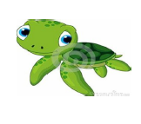

KS1 Class Structure
KS1 is arranged into two Year1 classes and one Year 2 class.
Terrific Turtles (Y1)
Teacher: Mrs R. Taylor
Perfect Pandas (Y1)
Teacher: Mrs E Cooper/Mrs B. Kane
Amazing Alligators (Y2)
Teacher: Mrs B. Blanchard
KS1 will be supported by TAs Mrs Critchlow, Mrs Munro and Mrs Stonier

Slide 3
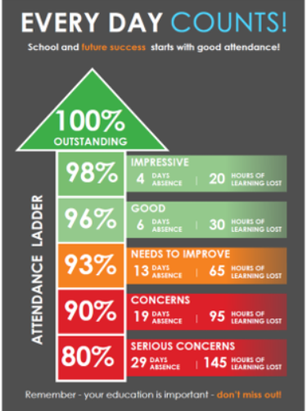
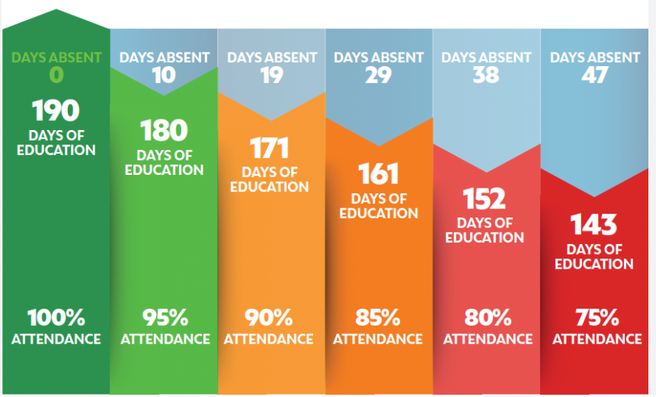
Attendance and Punctuality
The school promotes the importance of good attendance and punctuality in order that our pupils achieve their best outcomes.
Our school target for attendance is 96.5%.
This equates to approximately 6 days of absence and 30 hours of lost learning.

Slide 4

We also promote the importance of punctuality and being in school, every day, ready, on time.
If pupils are late by just 5 minutes each day, this equates to 3 full days or 15 hours of lost learning over the academic year.
Please reach out to us at school if you are experiencing difficulties with punctuality or attendance and we will support however we can.
https://www.youtube.com/watch?v=xI1PE1fC2h4
https://www.youtube.com/watch?v=_i5KxggkPTw

Slide 5
Oxhey Uniform
Children are asked to wear full school uniform:
Green jumper or cardigan
White t-shirt or shirt
Grey trousers, skirt or pinafore dress
Grey shorts or green checked summer dress
Black shoes (boots can be worn in bad weather, with a change of shoes in bags)
Please ensure all uniform is named.

Slide 6

Reading
Children will take home a home reading book of a level suitable for them.
If your child takes part in phonics lessons at school, they will bring home a phonics book, matched to the sound they are currently learning. This needs to be read 3 times.
Children who are reading a reading scheme book eg. blue, green, orange, turquoise and purple will be asked to read their book 3 times before it is changed.
Children reading gold and white books will be asked to read their books twice.
Please sign your child’s planner when they have read so we know when they are ready for a new book and they can move up the reading ladder.

Slide 7

Phonics
Phonics is an approach to the teaching of reading by breaking words down into the individual sounds. Daily phonics sessions take place every morning.
At Oxhey, we use the ‘SoundsWrite’ phonics scheme.
This is a methodical approach that introduces sounds progressively and allows children to secure their phonic recognition.

Slide 8
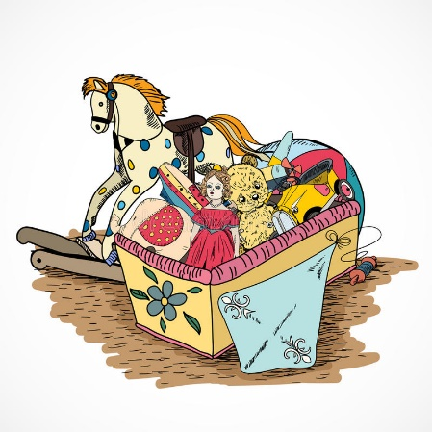

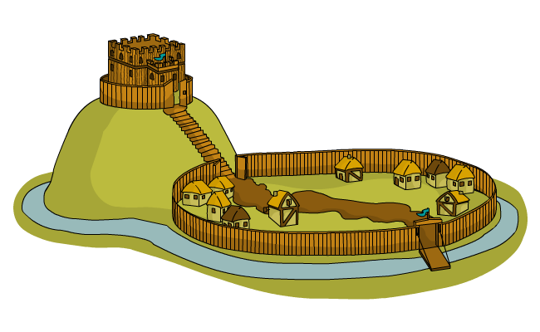
Non-Core Curriculum:
Throughout Key Stage 1, non-core subjects (History, Geography, Art, D&T, Music, Computing, R.E., PSHE) are taught as discrete units of work. There is an overarching key question that the unit will aim to answer and the series of lessons will build up to a ‘composite’ – a piece of work which demonstrates the child’s understanding of the subject area.

Slide 9

Promoting Independence
In all lessons, we try to ensure children take responsibility for their learning. We aim to promote independence in a variety of ways in the classroom, including:
Working walls
Access to concrete equipment
Word mats
Peer assessment
‘5 B's’ – Brain, Board, Book, Buddy, Boss
Self-help boards

Slide 10

Happy learners make great progress!
Various activities throughout the school day focus on promoting the children’s wellbeing and allowing them to reflect on their learning, relationships and feelings for example:
Zones of Regulation and self-help toolkits
Worry boxes
Circle times/PSHE lessons
Assemblies
Drawing and Talking sessions (MHST)

Slide 11
National Assessments
In the summer term, Year 1 children take part in a national assessment.
Year 1: Phonics Screening (June 2027)
Further information regarding the Phonics Screening Check will be provided during the next academic year.

Slide 12

Homework
Homework this term will consist of:
  Reading
  Spellings Practice
  NumBots
  There is a homework menu with activities for you to choose from. We ask that these are completed in homework books where possible.

Slide 13

Spellings
Spellings are sent home on Friday.
Children will have a combination of common exception words for their year group, and words with their current phonics/spelling rule focus.
Please support your child with learning the spelling/phonics patterns at home.
The test will take place every Thursday and their score will be recorded in their planners.
In September, a new spelling scheme will be introduced across Year 2 – Year 4. Further information regarding this will be shared in the new academic year.

Slide 14

P.E.
P.E. in Key Stage 1 takes place on a Friday afternoon. Throughout the year, children will take part in:
Dance
Gymnastics
Games
Children will need to come to school in their P.E. kit.
White t-shirt
Green shorts (In colder weather, children can also wear dark-coloured jogging bottoms or leggings)
Trainers/pumps
Please name all kit, including footwear.

Slide 15

Forest School
This year, all classes have been scheduled a 4 week block of Forest School sessions in the school grounds.
Children will take part in a variety of outdoor activities led by specialist Forest School teacher, Mr. Fox.
Children will need a set of weather-appropriate clothes that you are happy to get very muddy!
Once we have confirmed the dates, we will let you know.

Slide 16

Snack
KS1 children are able to have a piece of fruit at morning break with the free fruit scheme.
The children can bring in an extra piece of fruit if they would like a snack during their afternoon playtime.
Lunch
Lunch is from 12:00pm – 1:00pm.
All KS1 children are entitled to a free school meal
Notes:
Pupil premium information - speak to KP call in office

Slide 17

Drop off
The current drop off times for the three Key Stage 1 classes are between 8:50-9am. A member of staff is available to greet them on the door and to take any messages.
Please ensure you have informed the member of staff on the door if arrangements for the collection of your child, at the end of the day, are different.
Collection is at 3:20pm from your child’s classroom door. A member of staff will dismiss your child to you. If you wish to speak to a member of staff at the end of the day, please wait until all children have been dismissed, for safeguarding reasons, so that all children can be handed over to parents safely.

Slide 18
Contacting School
If you have any questions or concerns, your first point of contact is your class teacher.
If you have further queries, appointments can be made with a member of the Senior Leadership Team, Assistant Headteacher (Mrs Holt) or Head of School (Mrs. Proffitt).
Mrs Proffitt or Mrs Holt will also be available on the main gate each morning for informal queries or questions.

Slide 19
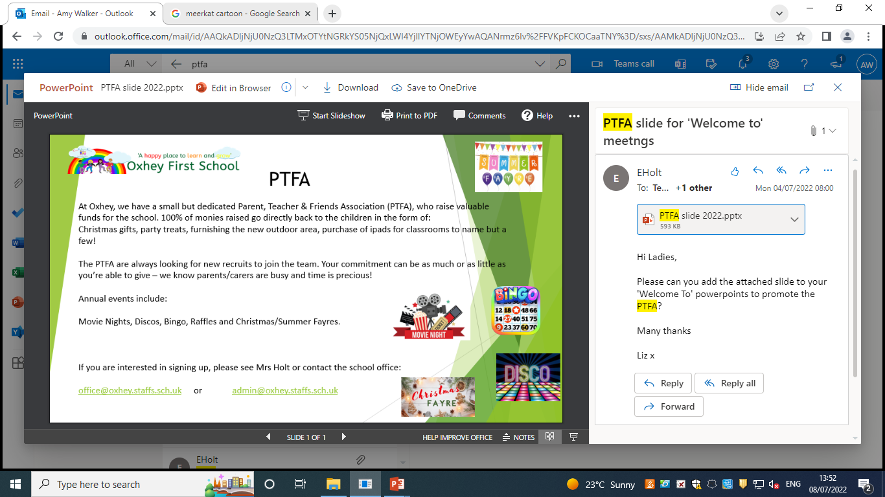

Slide 20
Please do not hesitate to get in touch if you have any questions.
Thank you.

